Slide 1
Using Raycast
Used to collide bullet to target
Usually in first person shooter game
Kristo Radion Purba

Slide 2
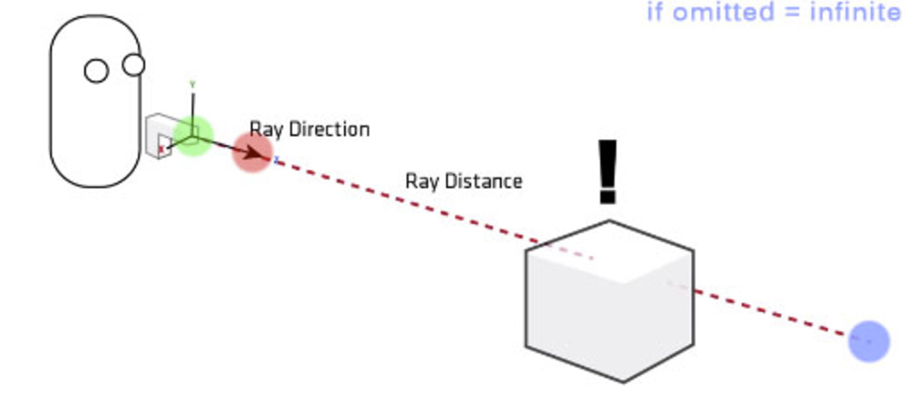
Definition
Raycast is a way to shoot a line from source (usually player) to target (usually a point x meters/pixels from the player's camera direction)
Raycast will detect collision to any collider in it's line. It will stop if it collides a collider.

Slide 3
Raycast for detecting bullet collision
Because bullet is very fast, we can't use regular collision using OnCollisionEnter event, because most likely it will skip colliders
By using raycast, we will cast a ray when player clicks mouse (to shot), and check where this ray collides.
At the point where the ray collides, we will create bullet explosion.
We will launch the bullet animation, but don't check collider using that bullet

Slide 4
Using Raycast
Add terrain
Add cubes as walls
Add RigidBodyFirstPersonController
Create player script attached to the FPS controller
Attach SmartCrosshair script to camera
Cast a ray in the update event
If player clicks mouse left button :
  Launch the bullet (Very fast)
  If the ray collides, also attach explosion to the raycast hit point. Better give some delay before the explosion

Slide 5
Start Coroutine
Coroutine is a way to give delay before executing a function.
Useful for creating delay before showing bullet explosion
Structure :
StartCoroutine(funcName(90)); //in update/start
IEnumerator funcName(float param){
yield return new WaitForSeconds(0.1f);
//function content here
}

Slide 6
Structure of raycast
// Update is called once per frame
void Update () {
RaycastHit hit;
float rayDist = 10.0f;
Vector3 forward = transform.TransformDirection (Vector3.forward
* rayDist;
Debug.DrawRay (transform.position, forward, Color.green);
if (Input.GetMouseButton (0)) {
if (Physics.Raycast (transform.position, forward, out hit)){
//beri ledakan pada target, jeda 0.1sec
StartCoroutine(attachExplode (hit.point));
}
attachBullet ();
}
}
rayDist : maximum length of the raycast
DrawRay : Draws the ray (check the Scene tab during play)
hit : The variable that stores the raycast result :
  hit.point : The contact point (Vector3)
  hit.distance : The distance of the contact point to the origin (number)

Slide 7
Attach Bullet, and Bullet Script
void attachBullet(){
var b = Instantiate (bulletPre) as GameObject;
b.transform.position = transform.position;
b.transform.rotation = transform.rotation;
//avoid collision with player
Physics.IgnoreCollision(
b.GetComponent<BoxCollider>(),
GetComponent<CapsuleCollider>());
Destroy (b.gameObject, 1); //delete after 1 sec
}
public class Bullet : MonoBehaviour {
float spd = 100.0f;
Vector3 move;
void Start () {
move = Vector3.forward * spd * Time.deltaTime;
}
void Update () {
transform.Translate (move);
}
}

Slide 8
Attach Explosion
This function will be delayed 0.1sec to simulate bullet arrival to target (called using StartCoroutine during mouse click)
IEnumerator attachExplode(Vector3 pos){
yield return new WaitForSeconds(0.1f);
var ex = Instantiate (explodePre) as GameObject;
ex.transform.position = pos;
Destroy (ex.gameObject, 1); //delete after 1 sec
}

Slide 9
Crosshair Script
Attach the script to the main camera
It will generate crosshair automatically, and creates spread effect automatically if the mouse button clicked simultaneously several times

Slide 10
using UnityEngine;
using System.Collections;
/// <summary>
/// A straightforward C# conversion of the JavaScript smartCrosshair (tentatively named)
/// Works similarly to original
/// </summary>
public class SmartCrosshair : MonoBehaviour
{
#region Fields
public bool drawCrosshair = true;
public Color crosshairColor = Color.white;
public float width = 1;
public float height = 3;
[System.Serializable]
public class spreading
{
public float sSpread = 20;
public float maxSpread = 60;
public float minSpread = 20;
public float spreadPerSecond = 30;
public float decreasePerSecond = 25;
}
public spreading spread = new spreading();
Texture2D tex;
float newHeight;
GUIStyle lineStyle;
#endregion
#region Functions
void Awake () {
tex = new Texture2D(1, 1);
lineStyle = new GUIStyle();
lineStyle.normal.background = tex;
}
void OnGUI () {
Vector2 centerPoint = new Vector2(Screen.width / 2, Screen.height / 2);
float screenRatio = Screen.height / 100;
newHeight = height * screenRatio;
if (drawCrosshair) {
GUI.Box(new Rect(centerPoint.x - (width / 2), centerPoint.y - (newHeight + spread.sSpread), width, newHeight), GUIContent.none, lineStyle);
GUI.Box(new Rect(centerPoint.x - (width / 2), (centerPoint.y + spread.sSpread), width, newHeight), GUIContent.none, lineStyle);
GUI.Box(new Rect((centerPoint.x + spread.sSpread), (centerPoint.y - (width / 2)), newHeight, width), GUIContent.none, lineStyle);
GUI.Box(new Rect(centerPoint.x - (newHeight + spread.sSpread), (centerPoint.y - (width / 2)), newHeight, width), GUIContent.none, lineStyle);
}
if (Input.GetKey(KeyCode.Mouse0)) {
spread.sSpread += spread.spreadPerSecond * Time.deltaTime;
Fire();
}
spread.sSpread -= spread.decreasePerSecond * Time.deltaTime;
spread.sSpread = Mathf.Clamp(spread.sSpread, spread.minSpread, spread.maxSpread);
}
void Fire() { }
void SetColor(Texture2D myTexture, Color myColor) {
for (int y = 0; y < myTexture.height; y++) {
for (int x = 0; x < myTexture.width; x++)
myTexture.SetPixel(x, y, myColor);
myTexture.Apply();
}
}
#endregion
}

Slide 11
