Slide 1
Using Canvas (UI)
Kristo Radion P

Slide 2
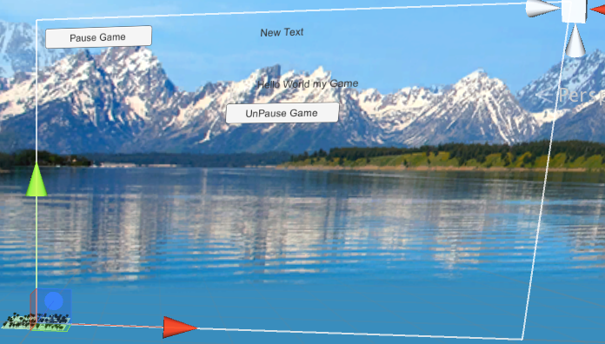
Definition
Canvas is a place to put UI elements in the game, e.g. buttons, text, bars (bar is an image), etc.
Canvas is a 2D element placed in the 3D world view.

Slide 3
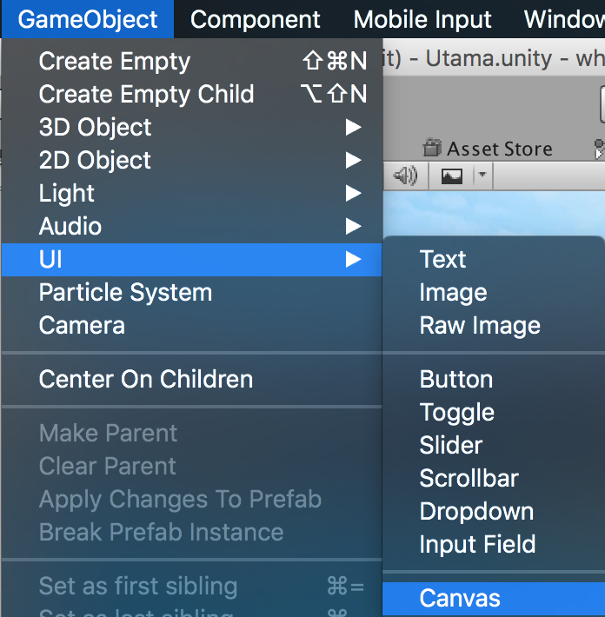
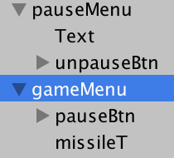
Notes
There can be more than 1 canvas in the game. E.g. 1 for main panels. 1 for pause menu that only be shown during game paused, etc.

Slide 4
Canvas Text
The easiest way to access the text via code is by assigning it to a Text public variable.
using UnityEngine.UI;
public Text missileT;
missileT.text = "Missiles "+num;
Drag the text from hierarchy to the public variable slot in Unity.

Slide 5
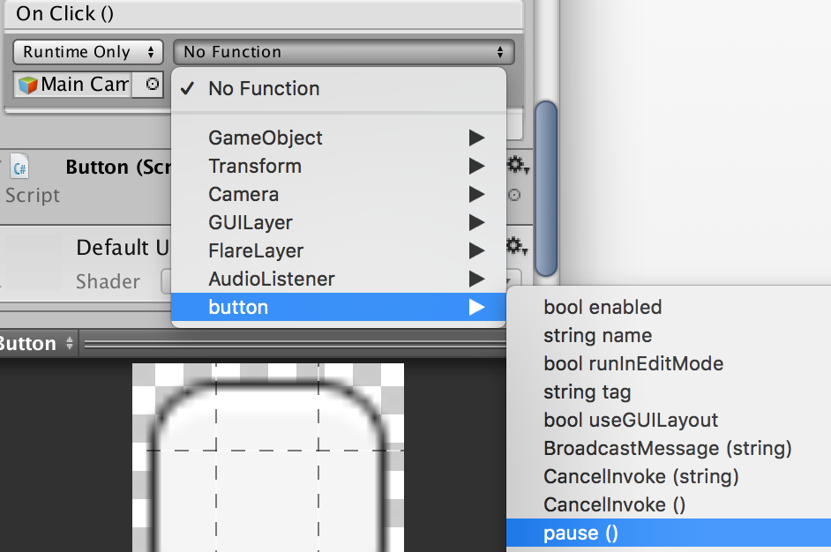
Canvas Button
To assign click event on button, we need a public function from a script, for example we will attach button.cs in MainCamera.
At the On Click() panel, click + button, then set as follows
2
1

Slide 6
Button.cs (attach to Main Camera)
public class button : MonoBehaviour {
GameObject gm;
void Start () {
gm = GameObject.Find ("pauseMenu");
}
public void unpause(){ //unpausing game
Time.timeScale = 1;
gm.SetActive (false);
}
public void pause(){ //pausing game
Time.timeScale = 0;
gm.SetActive (true);
}
}

Slide 7
Pausing the Game
Pausing the game is by using Time.timeScale = 0
Unpausing by setting it to 1 (100%)
timeScale is also useful for creating slow motion effect, e.g. set it to 0.25 (25%) to slow down the game during player casting a spell.

Slide 8
Canvas Slider
e.g. Volume slider
Value is between 0 and 1.0f.
Getting or setting the value using .value, e.g. :
sliderTest.value = 0.9f;
Assigning event for value changed :
sliderTest.onValueChanged.AddListener(delegate{
sliderTestChanged(); });
public void sliderTestChanged(){
Debug.Log("Slider changed to"+
sliderTest.value); //from 0 to 1.0f
}

Slide 9
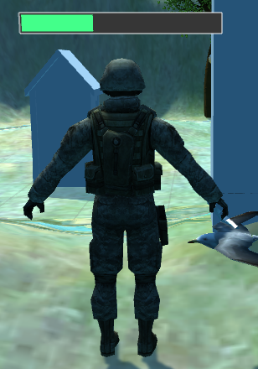
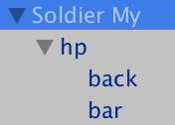
Health Bar in Enemy
Attach Canvas to the enemy prefab, name it "hp"
Add image to the canvas, name it "back"
Add image, name it "bar"

Slide 10
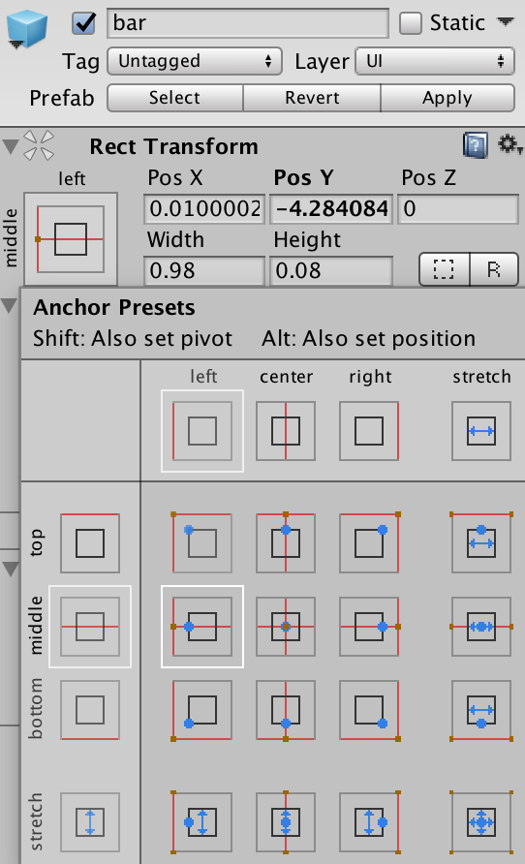
Setting the bar
Assign black color to the "back"
Assign green color to the "bar".
For "bar", set the anchor to middle left, so that it scales from the left side

Slide 11
Billboard Effect (Always face forward)
Attach new script named HPBar to the "hp" canvas
We will make bar always facing to the same direction (forward direction)
To make it easier, we will make static class for miscellaneous purposes.
public class mi
{
public static void lookCam(MonoBehaviour obj){
//objek selalu menghadap kamera tp lurus (billboard effect)
var c = Camera.main;
obj.transform.LookAt (obj.transform.position + c.transform.rotation * Vector3.back,
c.transform.rotation * Vector3.down);
}
public static void constantScale(MonoBehaviour obj, float mult){
//ukuran objek sama, regardless seberapa jauh dari kamera
float dist = Vector3.Distance(Camera.main.transform.position, obj.transform.position ) * mult;
obj.transform.localScale = Vector3.one * dist;﻿
}

Slide 12
using System.Collections;
using System.Collections.Generic;
using UnityEngine;
public class HPBar : MonoBehaviour {
float num; //angka 0-1, karena hp di-maintain di unit sendiri
Vector3 oriScale;
GameObject bar;
bool alreadyInit = false;
void Start () {
CheckInit ();
}
void CheckInit(){
if (!alreadyInit) {
alreadyInit = true;
oriScale = transform.localScale;
bar = transform.Find ("bar").gameObject;
setNum (1);
}
}
void Update () {
mi.lookCam(this);
mi.constantScale (this, 0.3f);
}
public void setNum(float n){ //antara 0-1 saja
num = n;
syncBar ();
}
void syncBar(){
CheckInit ();
bar.transform.localScale = new Vector3(num, 1,1);
}
}

Slide 13
Setting the HP in Enemy
We can set the enemy's HP bar from the enemy script by calling setNum in HP.
//global vars
GameObject hpbar;
private HPBar hpscript;
//in Start
hpbar = transform.Find ("hp").gameObject;
hpscript = hpbar.GetComponent<HPBar> ();
hpscript.setNum (1.0);
//in Update
hpscript.setNum (0.7);
//here we can check for weapon damage before setting the setNum. Values is between 0-1

Slide 14
Clicking Mouse on Terrain
In some games, clicking mouse on the terrain will move the character there, or launching rocket/bullet
This can be done by using Raycast. The raycast will be sent from camera position to the ground, and it will check the collided position (on ground) of the ray.

Slide 15
Cam Script (attach to main camera)
public class CamScript : MonoBehaviour {
public static RaycastHit hit;
// Update is called once per frame
void Update () {
rayControl ();
}
void rayControl(){
//draw raycast to mouse position
Ray ray = Camera.main.ScreenPointToRay(
Input.mousePosition);
if (Physics.Raycast (ray, out hit)){
Debug.DrawLine (transform.position, hit.point,
Color.red);
}
//drawline is visibile in "Scene" tab during game
}
}

Slide 16
Player script when clicking mouse
Global Var and Start
//global var
GameObject groundPointPre;
//Start
groundPointPre = Resources.Load ("groundPoint")
as GameObject;
//first, put the groundPoint (can be a cube) to the Assets->Resources folder
In Update
if (Input.GetMouseButtonDown (0)) {
//attach mouse click position on the ground
var gp = Instantiate(groundPointPre) as GameObject;
gp.transform.position = CamScript.hit.point;
}

Slide 17
Managing Scene
Scene is used to separate game screens, e.g. main menu and in-game scene
In this example, we will create a button, and when the button is clicked, we will go to another Scene.
We will have 2 scenes (creating scene is by using File -> New Scene), and don't forget to save the scenes, for example "Main Menu" and "In Game".
Scene will be saved in the assets folder in the project. In the newly created scene, save it first (file -> save scene)

Slide 18
Main Menu
In the Main Menu, we will create button labelled "Start Game". Do the following :
In the main camera, create ButtonScript.cs, containing :
using System.Collections;
using System.Collections.Generic;
using UnityEngine;
using UnityEngine.SceneManagement;
public class ButtonScript : MonoBehaviour {
public void startGame(){
SceneManager.LoadScene ("In Game");
}
}

Slide 19
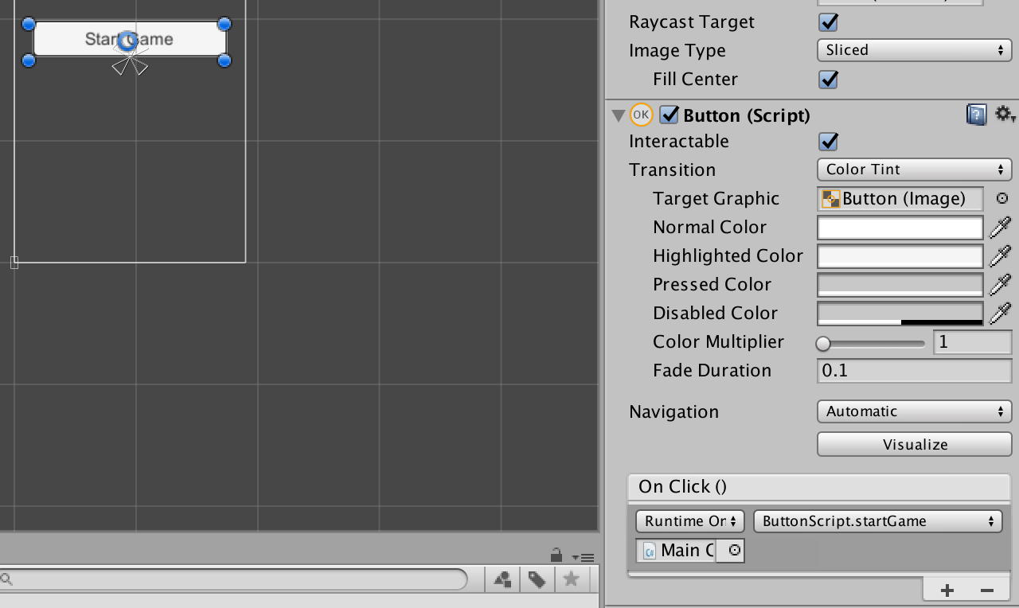
In the Start game button, add On Click() event by clicking + icon. And then, drag the main camera to the Game Object selector, and then set the script to ButtonScript -> startGame(), so it looks like this :

Slide 20
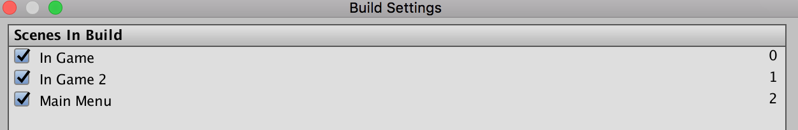
Before we can go to other scene when clicking a button, first we need to add our scenes to be included in the game, in the Build Settings.
Go to the File -> Build Settings, and then click Add Open Scene.
For all scenes we wanted to include in the game, we must open the scenes one by one, and then go to the "Add Open Scene" for each opened scene. It looks like this after adding the Scenes :
The SceneManager.LoadScene will work after we already add the scenes to be included in the game in the Build Settings.

