Slide 1
Using Animation (Alternative to Animator Controller)
Kristo Radion P

Slide 2
Animation
Animation is a legacy feature of Unity, prior to Unity 5
Using Animator Controller is encouraged. But sometimes Animation have advantage, i.e. :
Different way to animate, sometimes easier to understand
Many animations in Unity Asset store still support Animation, or not yet updated to newer Animator Controller

Slide 3
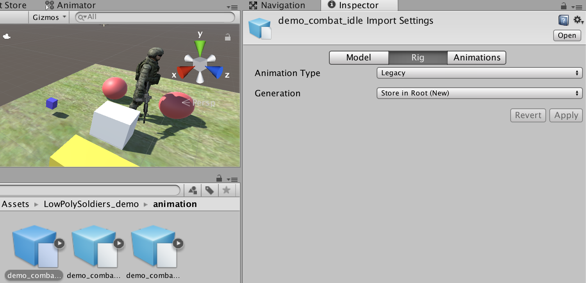
Low Poly Soldier Animation
This asset can be used for Animation as well
Before using, assign the animation type to legacy, for all 3 animations

Slide 4
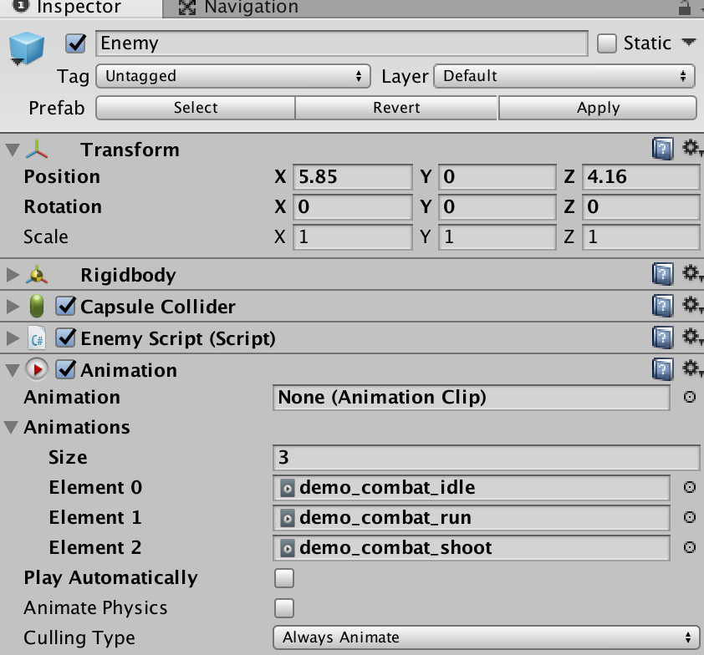
Assigning the Component
We can create prefab first, name it "Enemy", so that we are not modifying the original asset
Assign the Animation component, and set it as follows. Uncheck the play automatically

Slide 5
Change animation state
To change animation state, simply use the following method :
var anim = GetComponent<Animation>();
anim.Play("demo_combat_run");
In this example, we will use navmesh agent to move the Enemy, like the previous chapter
The logic :
When the distance to target is very near (almost stopping), we will play "idle"
When moving, we will play "run"
Script available in the next slide

Slide 6
In the enemy movement script, try to add the following codes
float dist = Vector3.Distance(transform.position,curDestination);
var anim = GetComponent<Animation>();
if(dist <= 1.0f){ //almost arriving
anim.Play("demo_combat_idle");
}else{
anim.Play("demo_combat_run");
nma.SetDestination(curDestination);
}

Slide 7
Experiment
How to use Animation to control animation of the player character?
How to create character movement that is based on mouse click, like Warcraft? Hints :
Check "Clicking Mouse on Terrain" section on Canvas UI chapter
Move the character using navmesh agent
Use the same code structure for animation, like the enemy

