Slide 1
Using Animator Controller
Kristo Radion P

Slide 2
Definition
Animator Controller controls the animation of a model using set of states.
Is new to Unity 5.
Contains one or more Animation model in .fbx format
Switches from one animation to other using set of conditions

Slide 3
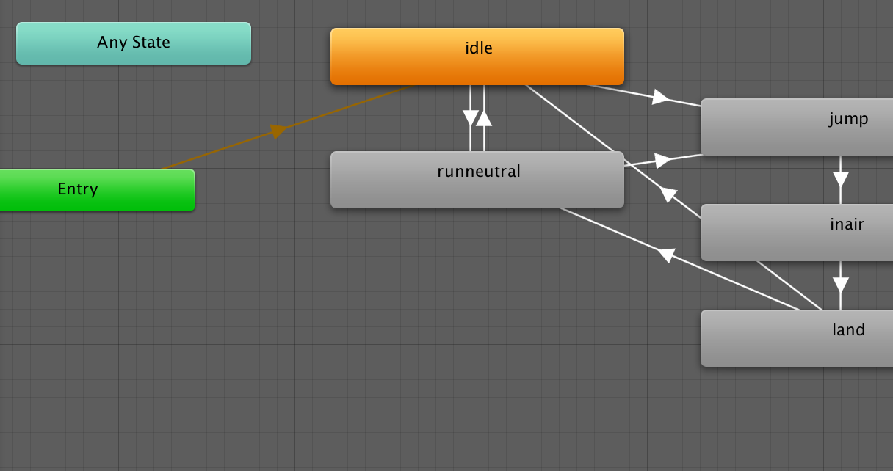
Animator Example

Slide 4
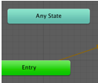
Creating Animator
Right click on assets, Create->Animator. This is the initial screen.
Any state can be used to switch to other state using condition. It will override other states. E.g. Unit dead animation.
Entry is the initial block.
Animator is a flowchart-like control block.

Slide 5
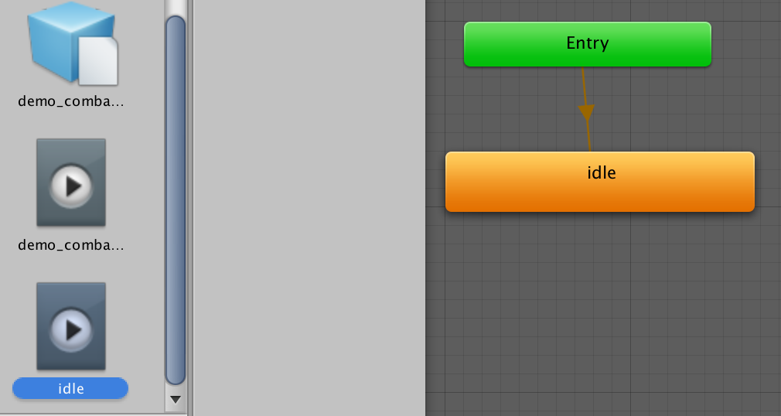
Creating Amanda Frost Animator
The initial animation of every unit is usually idle (breathing). Drag the idle fbx to animator window.
It will automatically set the arrow from entry to idle

Slide 6
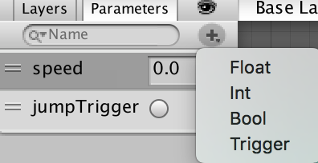
Amanda Run
We will goto Run state, if the speed is >= 0 or >= 0.1. And go back to idle if otherwise.
First we will create the speed variable inside the animator. For speed, float is suitable.
Later we will assign speed using Input.GetAxis values (from 0.0 to 1.0)
Trigger is a boolean variable, but after used it will be toggled to false (we will use it for jump)

Slide 7
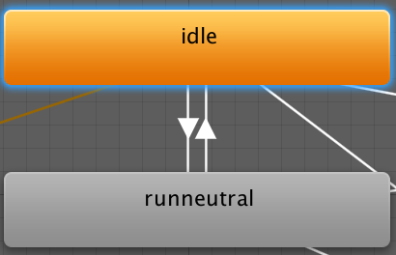
Drag the runneutral animation.
Right click on the idle, make transition, to runneutral. Also from runneutral, to idle.

Slide 8
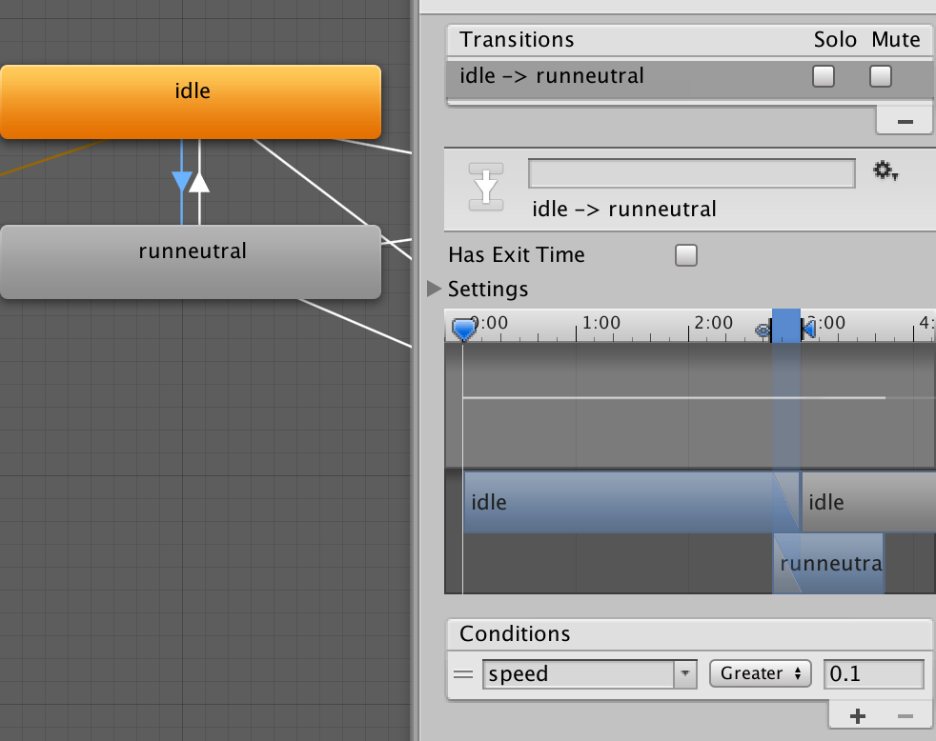
Click the arrow from idle to run. Uncheck has exit time. Set the condition to speed greater than 0.1.

Slide 9
Has Exit Time
Has exit time defines it will stay and loop in this animation.
If checked it will execute the state after the animation finished. Usually used for sequential animations, e.g. jump to in air animation.
If unchecked, it can execute the state anytime as long as the condition met. Usually used for jumping from/to other state, e.g. idle to run or run to idle.

Slide 10
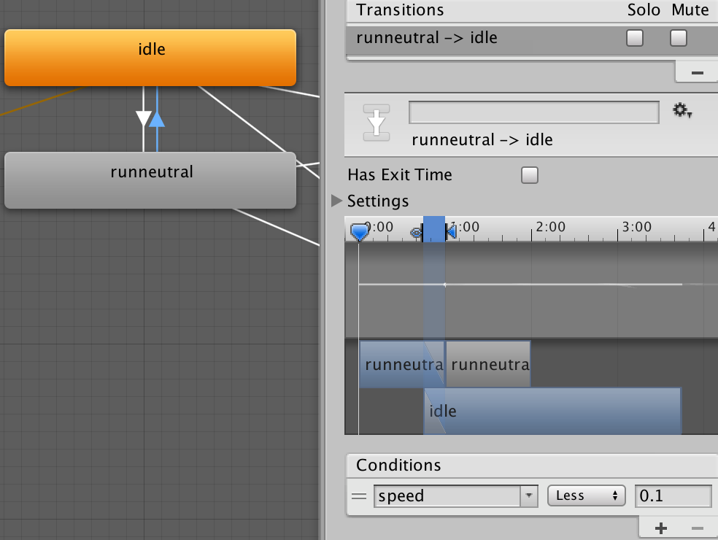
From run to idle, speed less than 0.1

Slide 11
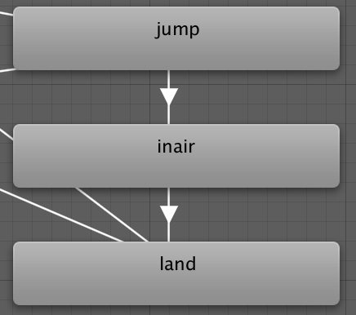
Jump animation
Create jumpTrigger variable. The type is trigger.
Drag jump, inair, land animation.

Slide 12
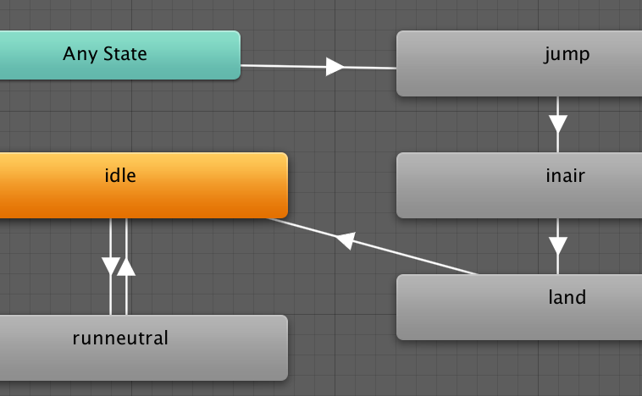
Transition from any state to jump
Jump can be from idle or run, thus we make the transition from any state.

Slide 13
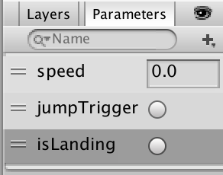
Make the trigger to jump and land

Slide 14
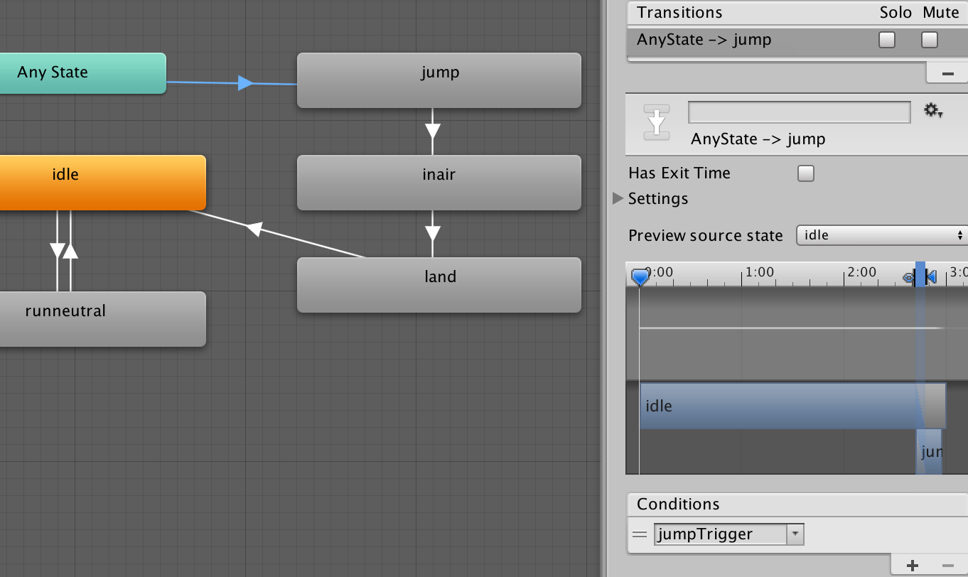
Any state to jump : Use jumpTrigger
Uncheck has exit time so that it can be triggered any time, not waiting for previous animation finished

Slide 15
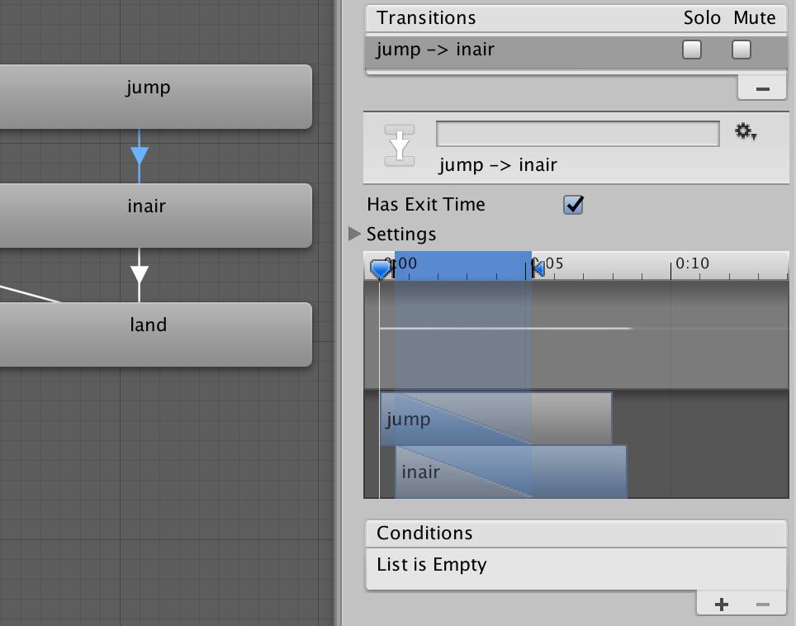

Slide 16
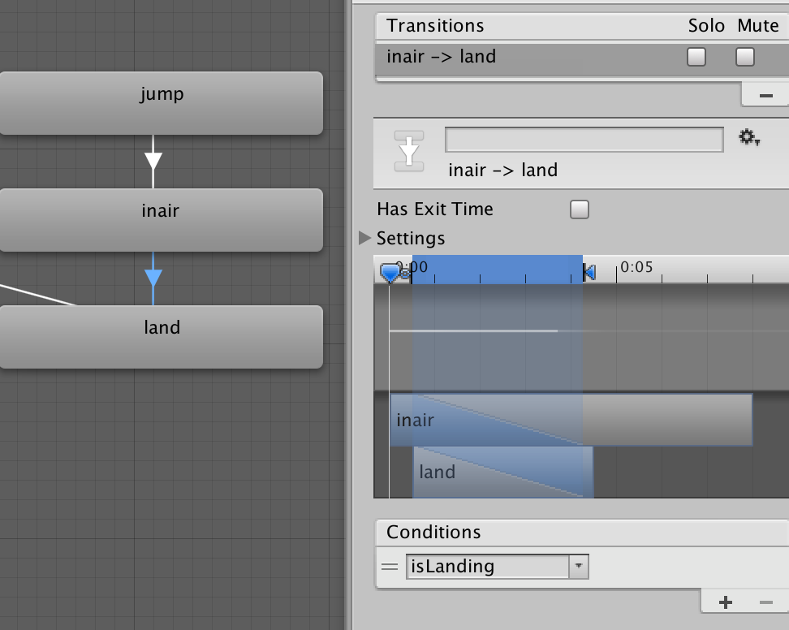

Slide 17
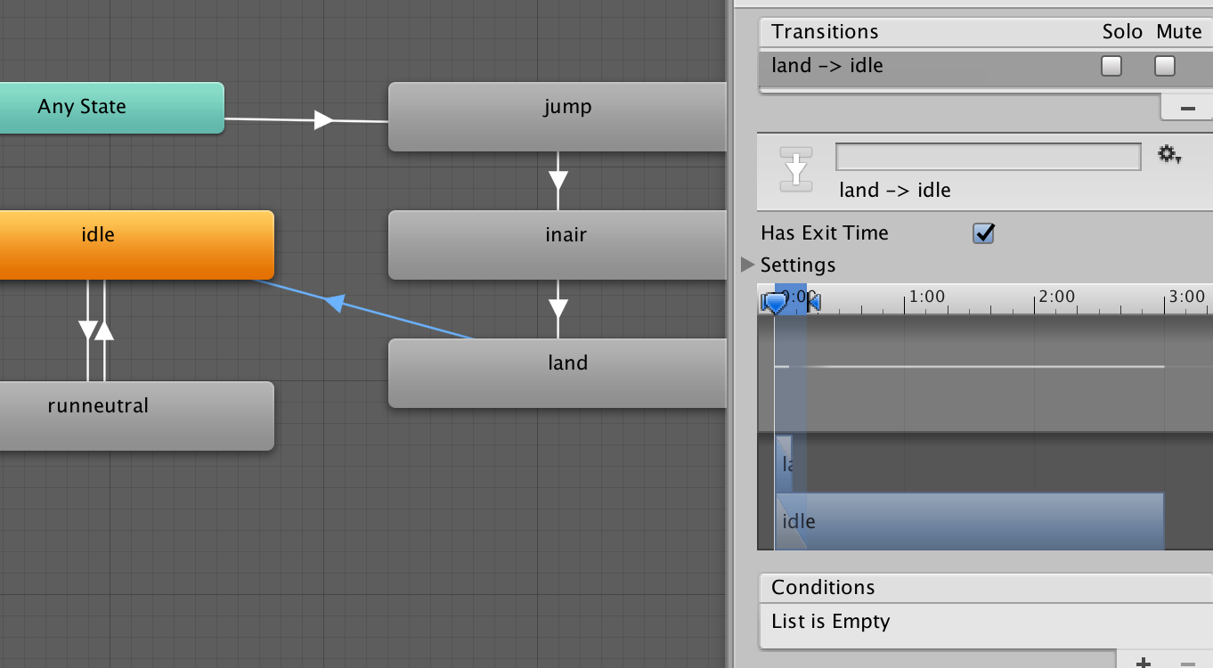

Slide 18
Note : We cannot return to Any State. Because Unity doesn't know where to go.

Slide 19
Scripting Amanda
Create amanda.cs.
Cache the anim object in Start() :
Animator anim; //in global scope
anim = GetComponent<Animator> (); //in start
Checking the current animation :
anim.GetCurrentAnimatorStateInfo (0).IsName ("inair")
Setting the variable :
anim.SetTrigger ("isLanding");
anim.SetFloat ("speed", axisSpd);

Slide 20
Idle to Run
float mh = Input.GetAxis ("Horizontal");
float mv = Input.GetAxis ("Vertical");
var axisSpd = Mathf.Max (Mathf.Abs(mh), Mathf.Abs(mv));
anim.SetFloat ("speed", axisSpd);

Slide 21
Jump
if (Input.GetKeyDown (KeyCode.Space) && hitGround) {
Rigidbody b = gameObject.GetComponent<Rigidbody> ();
Vector3 jumpVec = new Vector3 (0, 9, 0);
b.velocity = jumpVec;
anim.SetTrigger ("jumpTrigger");
}

Slide 22
Check Landing
void OnCollisionEnter(Collision c){
//Debug.Log (c.gameObject.name + " ENTER collision " + name);
if (c.contacts[0].normal.y >= 0) {
hitGround = true;
if (anim.GetCurrentAnimatorStateInfo (0).IsName ("inair")) {
anim.SetTrigger ("isLanding");
Debug.Log ("Hit ground");
}
}
}

