Slide 1
Navigation Mesh
Game Development
Kristo Radion Purba

Slide 2
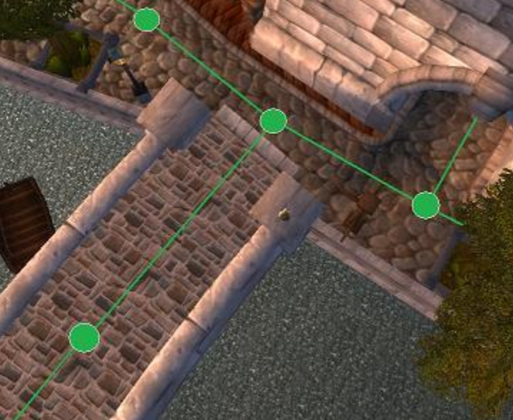
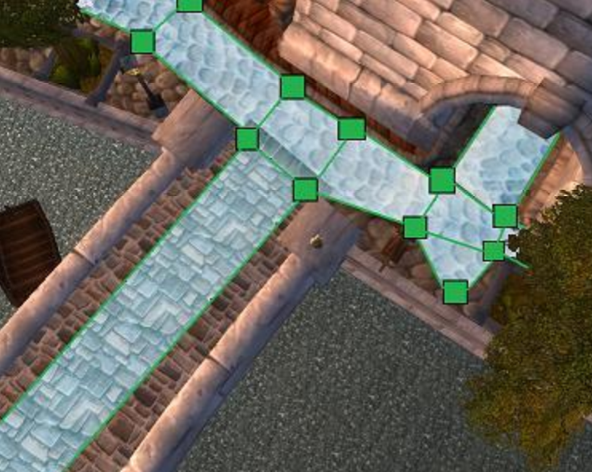
Waypoint vs Nav Mesh

Slide 3
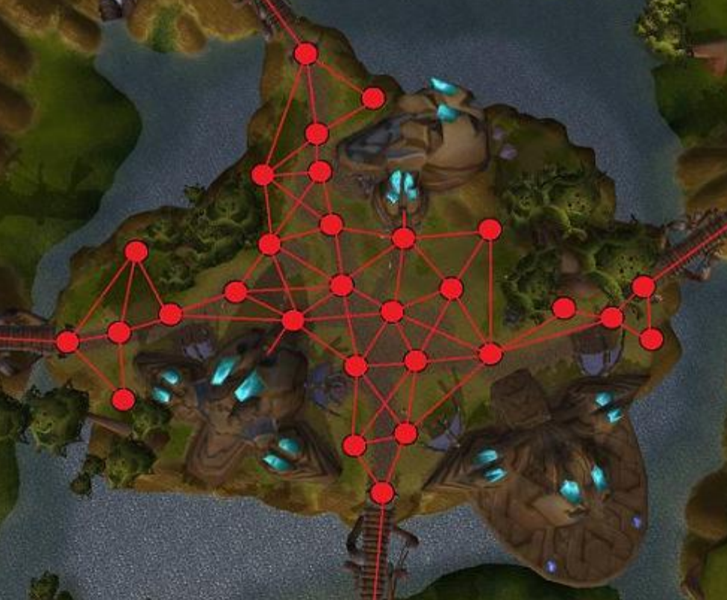
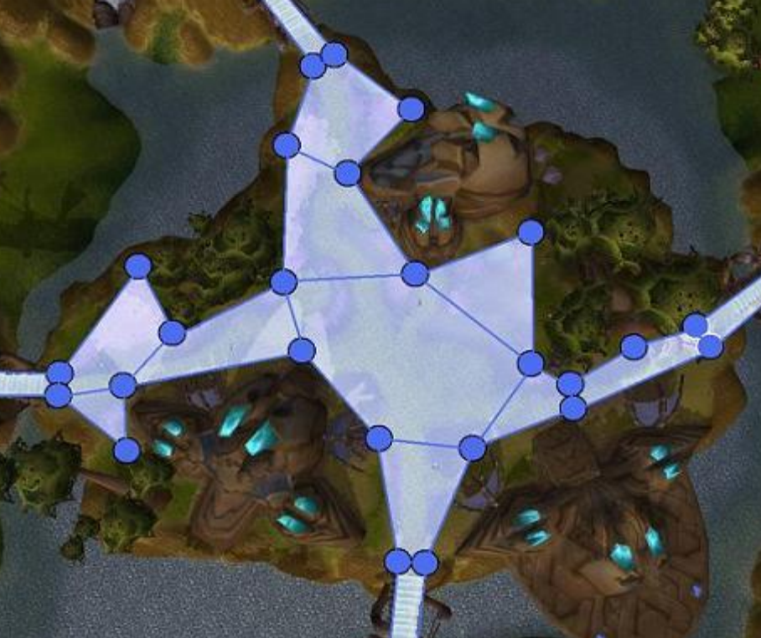
Why Waypoint Are Bad
Some kinds of game worlds require a ridiculous number of waypoints

Slide 4
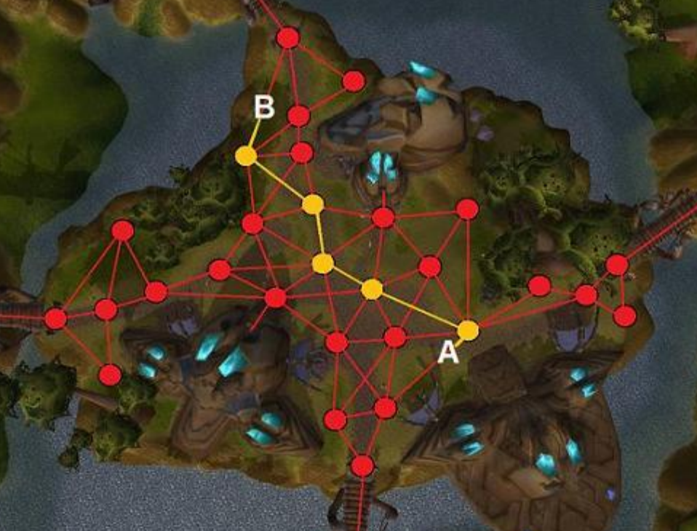
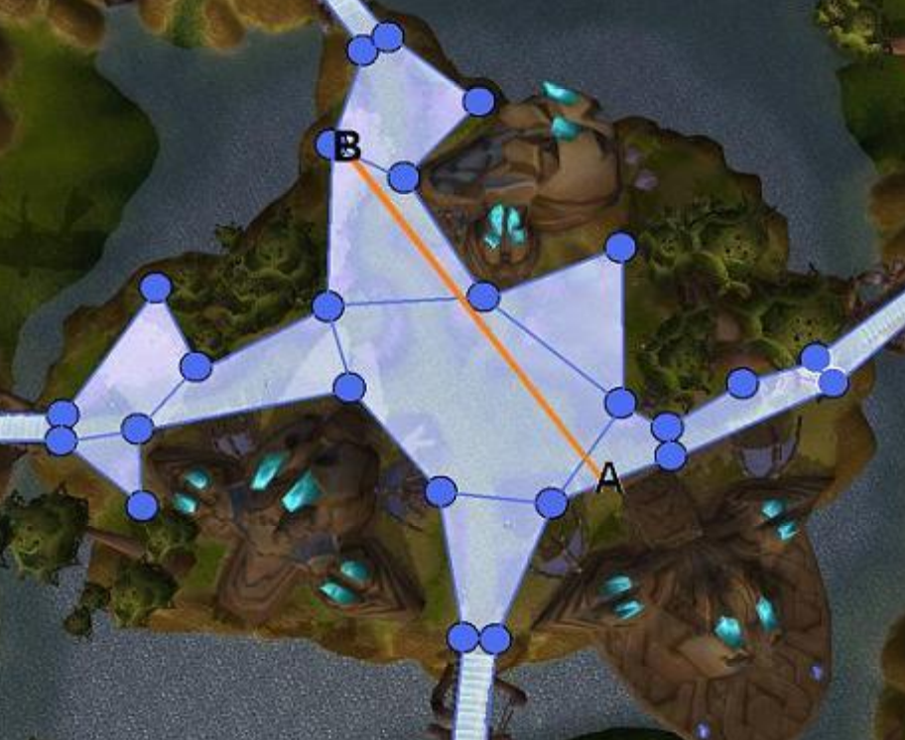
They make characters "zig-zag" as they move.

Slide 5
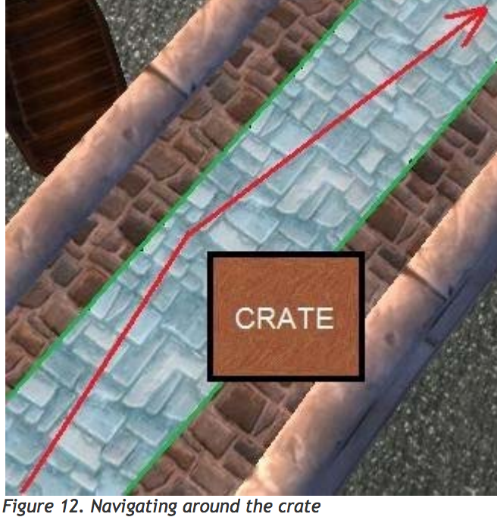
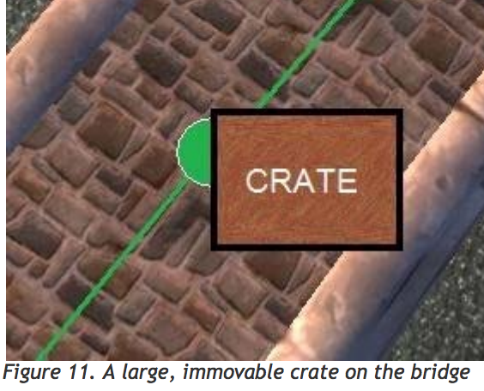
They don't allow path correction. That makes robust dynamic obstacle avoidance difficult, if not impossible

Slide 6
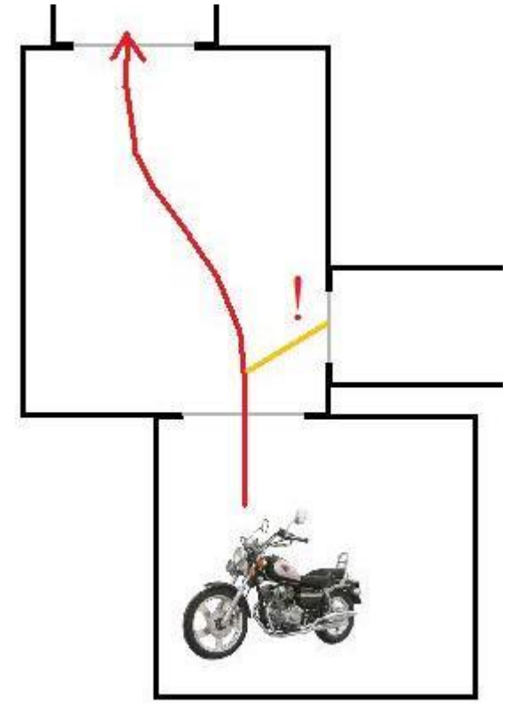
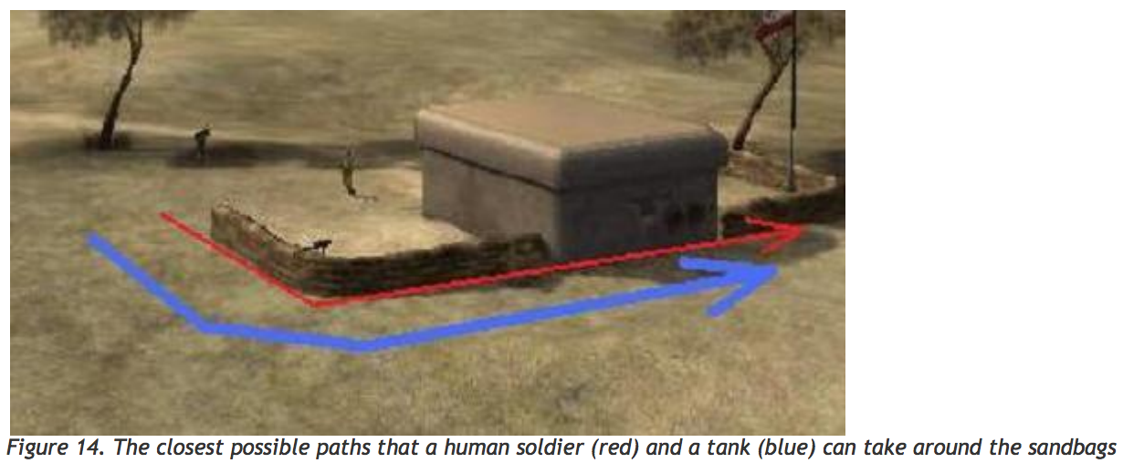
They don't work robustly for characters that move differently.

Slide 7
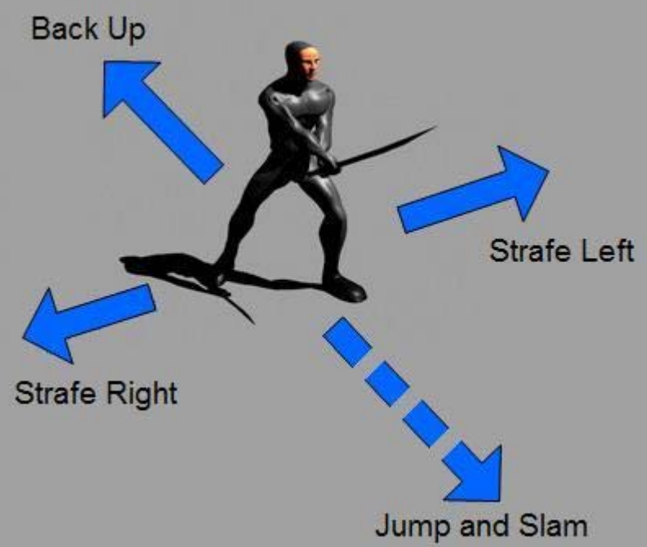
They don't have enough data to support what your AI needs beyond pathfinding :
A game character needs to constantly query the pathfinding system and ask: is it OK if I move here? How about over here?

Slide 8
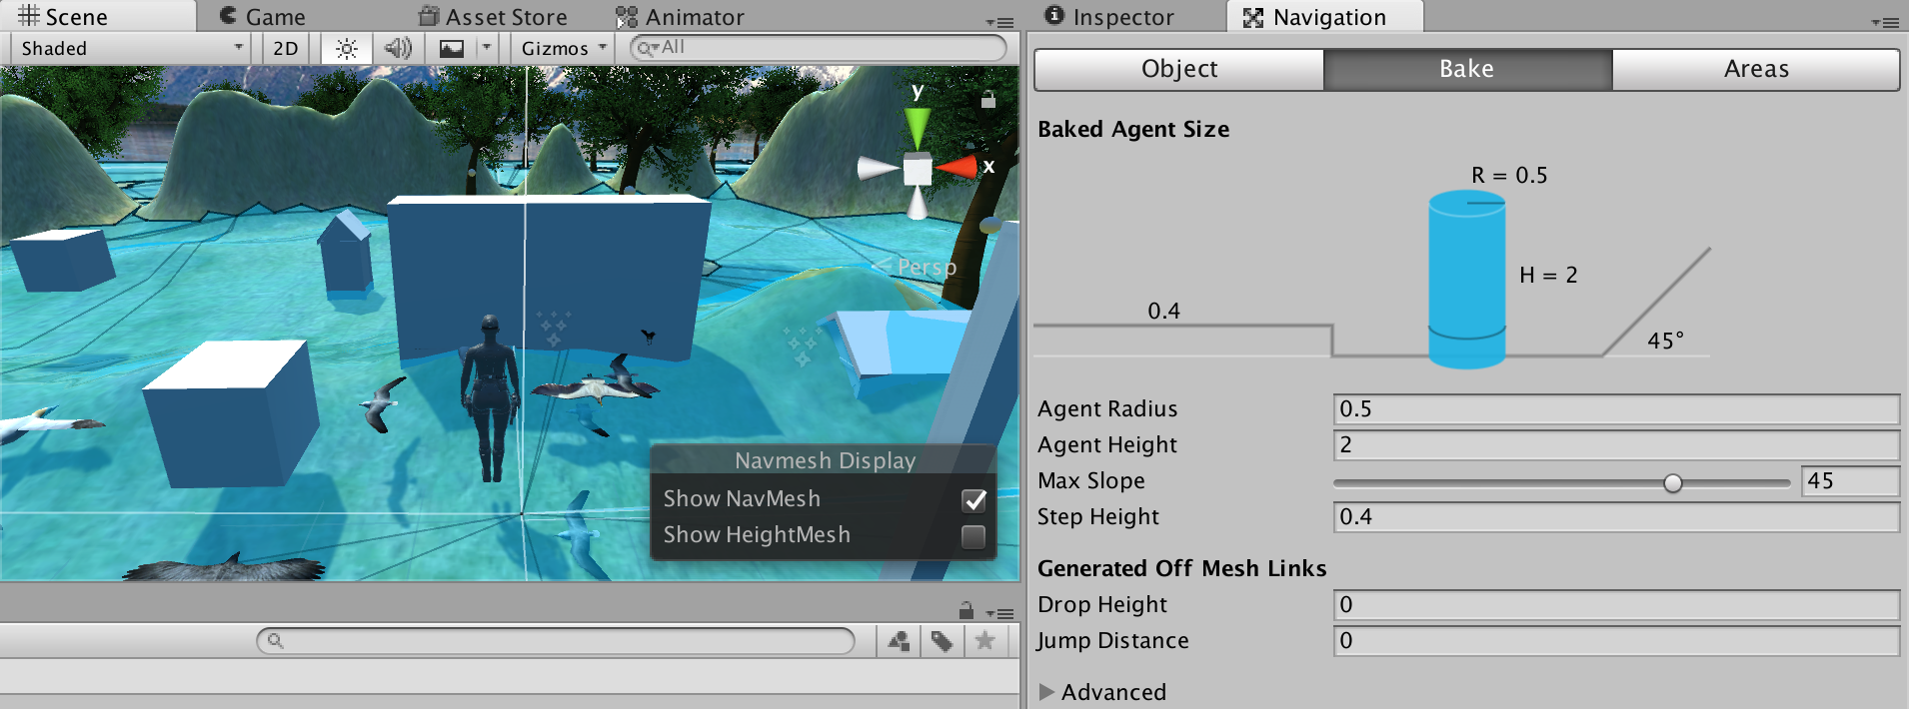
Using Navmesh in Unity
Select a terrain.
Put obstacles in the terrain ground. Make it collide with the terrain. If not colliding (e.g. Floating object), it will not be considered as obstacle.
Window -> Navigation. Select Bake tab, click Bake

Slide 9
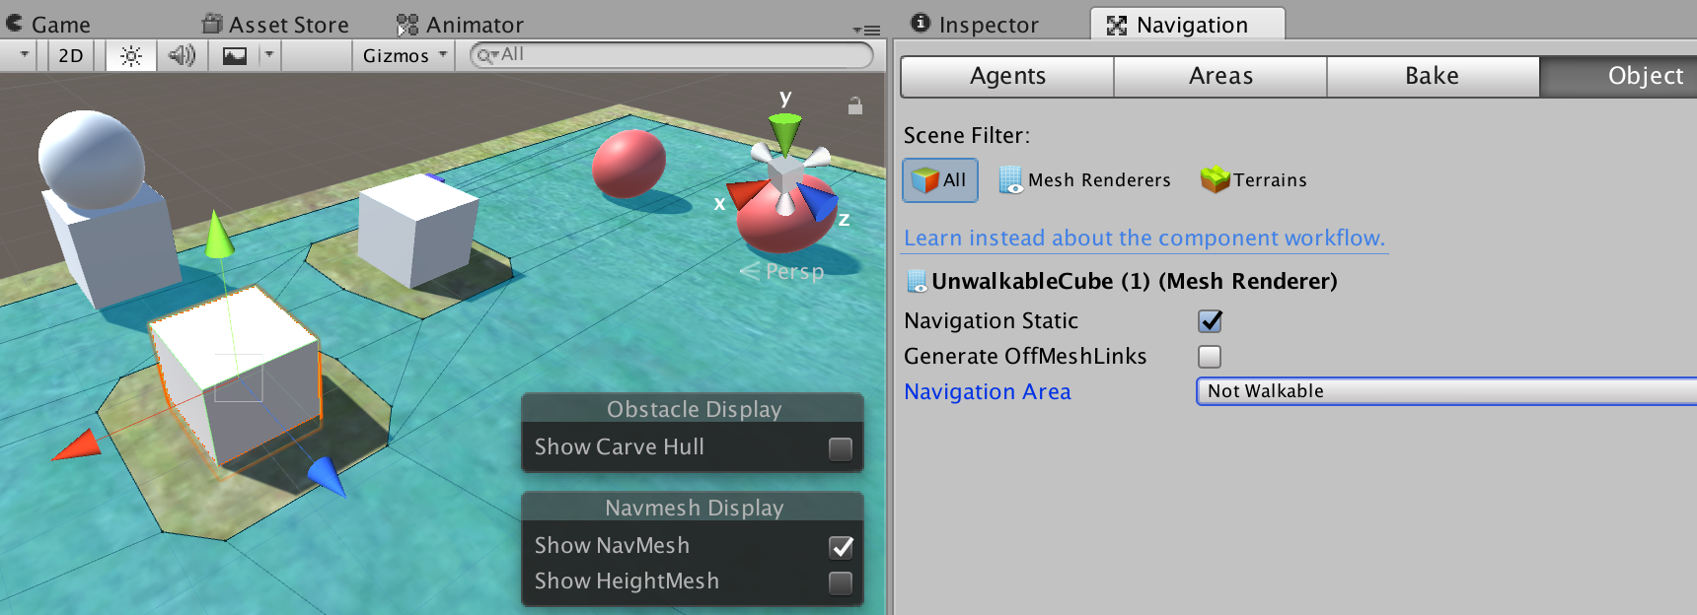
Put static object as obstacle
Any static objects can act as an obstacle in the navmesh. In this example, we will use Cube as an unwalkable cube.
From the navigation tab, select Object. Set not walkable (see picture)
After that, press Bake again

Slide 10
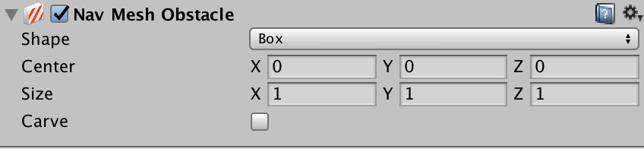
Dynamic Obstacle or Floating Object
You can register an additional object as an obstacle
Add nav mesh obstacle component in the Game Object. You can adjust the shape, size and center
Our player should also use nav mesh obstacle, so that the enemies won't try to push through the player

Slide 11
Creating Moving Cube
In this example, we will create a moving cube as an obstacle in the navmesh
Assign nav mesh obstacle component to any moving objects that is intended to become an obstacle, like moving cube and the player
Later, we will use the nav mesh agent for the enemy movement on the map. While the player will still use WASD control.
Note : Nav mesh agent can also be used in the player, for a game that is controlled using mouse only, like Warcraft and Starcraft.

Slide 12
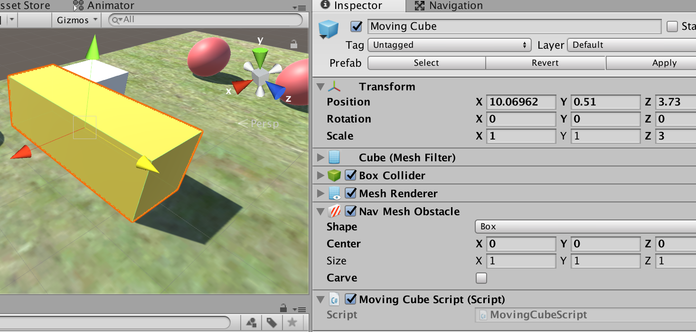
The moving cube
Create a cube, give yellow color, create as a prefab
Assign movingCubeScript

Slide 13
Using the following script in the MovingCube, the cube will move forward and backward in Z
public class MovingCubeScript : MonoBehaviour {
float resetDelay = 1f; //seconds
float curDelay = 0f;
float moveZ = 5f;
void Update () {
var dt = Time.deltaTime;
transform.position += new Vector3(0,0,moveZ)*dt;
//calculate the delay
curDelay += dt;
if(curDelay >= resetDelay){
//reverse the direction
moveZ = -moveZ;
curDelay = 0;
}
}
}

Slide 14
Moving the Object using Nav Mesh
Vector3 targetPos =
new Vector3 (targetX, targetY, targetZ);
NavMeshAgent nav = gameObject.GetComponent<NavMeshAgent> ();
nav.SetDestination (targetPos);
Remember, because of the GetComponent is a CPU-heavy process, assign the nav in Start, make the NavMeshAgent as global variable.
nav.SetDestination should run everytime, in Update.

Slide 15
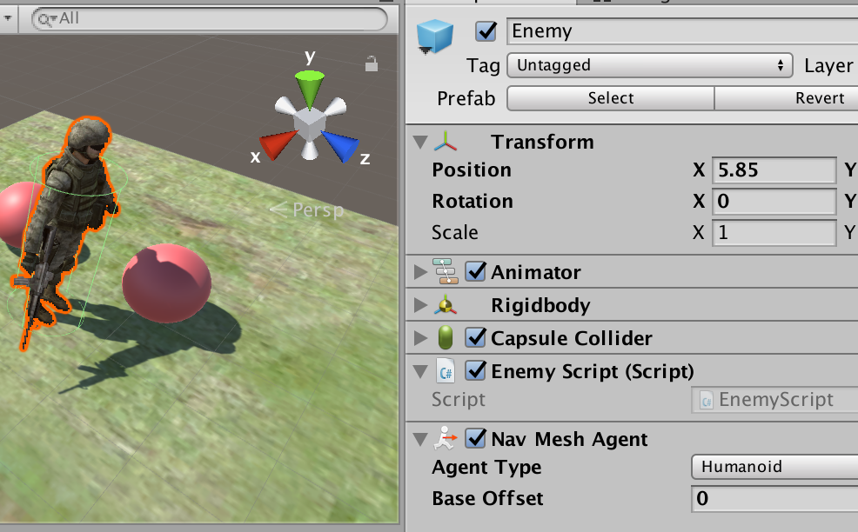
Put the nav mesh agent in the enemy

Slide 16
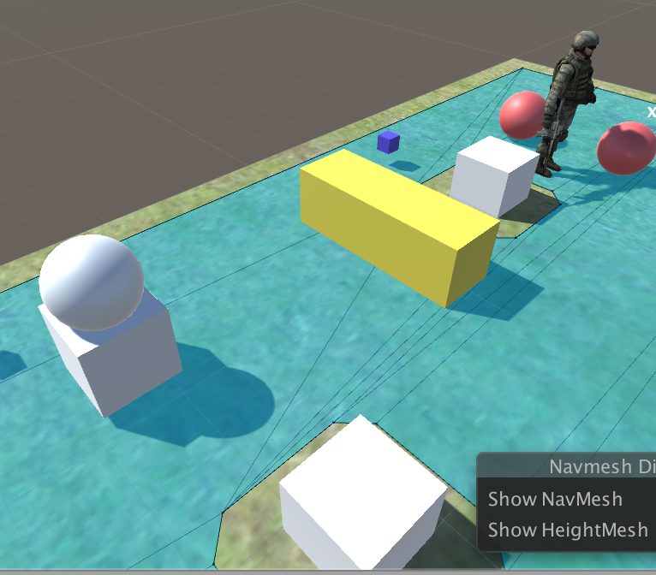
Place the enemy on the following position, to prove that the static cube (white) and the moving cube (yellow) works as an obstacle
In this example, we will first try to move the enemy to player's position

Slide 17
Moving the enemy to player's position
(EnemyScript.cs in the Enemy)
void Update () {
MoveToPlayer();
}
void MoveToPlayer(){
var pl = GameObject.Find("Robot");
var nma = GetComponent<UnityEngine.AI.NavMeshAgent>();
nma.SetDestination(pl.transform.position);
}

Slide 18
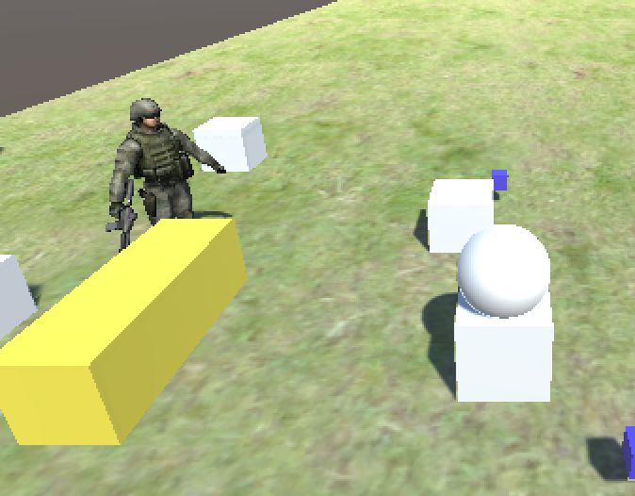
Enemy avoids moving cube and the static cube to reach the player

Slide 19
Moving Enemies to Random Destination
In this example, we will use LowPolySoldier as the enemy, like the previous slides (instantiating object and prefab)
Every random chance, enemy will change destination
It will navigate to the destination
Preparation
  Assign navmesh to the terrain
  Assign navmesh agent to the enemy
  Assign navmesh obstacle to player
Full script in the next slide

Slide 20
Vector3 curDestination;
float changeDirChance = 0.05f; //5% of chance
void Update () {
MoveControl();
}
void MoveControl(){
//reset the destionation if no current destination or met the chance
if(curDestination == null || Random.Range(0f,1.0f)<changeDirChance){
var px = Random.Range(0,500); //in pixel
var pz = Random.Range(0,500);
curDestination = new Vector3(px,0,pz);
}
//go to destination
var nma = GetComponent<UnityEngine.AI.NavMeshAgent>();
nma.SetDestination(curDestination);
}

Slide 21
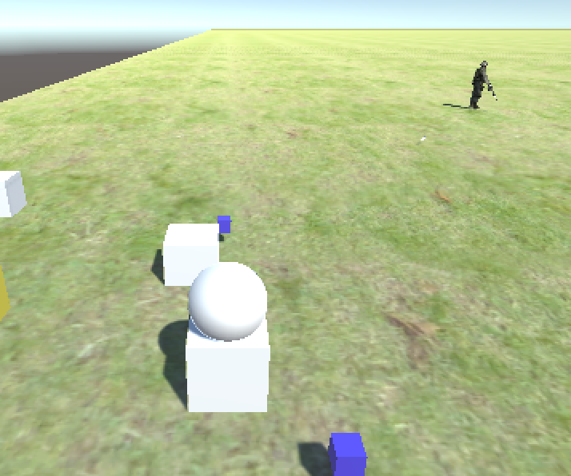
Now, the enemy is walking around
Experiment : How to make the enemy more likely to approach the player rather than wandering around?
Hint : Use chance

Slide 22
Making walkable building
We can create a walkable building using cubes, so a map will not always use terrain as the ground
We can also make more than 1 floor
Create an empty first, name it "building"
Create cubes as floors, stairs, walls as a children of the building

Slide 23
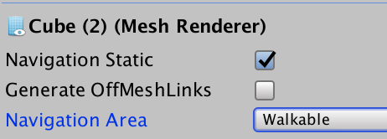
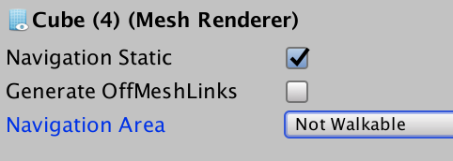
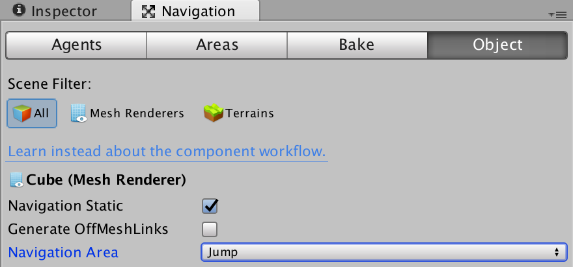
For the walkable area (stairs, floor) check navigation static, then set "walkable"
For the unwalkable area (stairs, floor) check navigation static, then set "not walkable"
For stairs, if it is to high, set it to "jump"

Slide 24
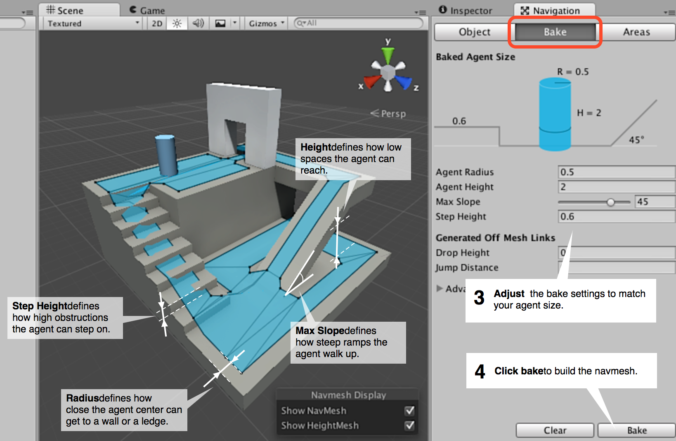

Slide 25
Getting a Random Position inside NavMesh
Useful to move enemy to a random position, but the position should be walkable
The disadvantage of random (x,z) from page 19-20, is the enemy can target a not walkable area
The function is available in the next page. The function is made static, and we can put it in a class that contains miscellaneous codes

Slide 26
using System.Collections;
using System.Collections.Generic;
using UnityEngine;
using UnityEngine.AI;
public class mi : MonoBehaviour {
public static Vector3 RandomNavPos (Vector3 origin, float distance, int layermask=-1) {
//get a random position inside nav mesh
//distance is the maximum distance from current position
//layermask -1 for all
Vector3 randDir = UnityEngine.Random.insideUnitSphere * distance;
randDir += origin;
NavMeshHit navHit;
NavMesh.SamplePosition (randDir, out navHit, distance, layermask);
return navHit.position;
}
//example : mi.RandomNavPos(transform.position, 50);
}

Slide 27
Sample Script for RandomNavPos
Inside the MoveControl from the previous slide, we can change the target position to a RandomNavPos
if(curDestination == null || Random.Range(0f,1.0f)<changeDirChance){
curDestination = mi.RandomNavPos(transform.position, 50);
}

