Slide 1
Components, Delta Time and References
Kristo Radion Purba

Slide 2
Time.deltaTime
Time.deltaTime is the ms difference between current frame and previous frame
deltaTime provides the way to create frame rate independent game
Example :
I want to move this object 10 pixels per second in X and Z :
transform.position += new Vector3(10,0,10) * Time.deltaTime
In constrast, if we are not using deltaTime, the above script will move the character 10 pixels per frame

Slide 3
Refer to a Component
In any script, we can refer to "this" object's component. Examples:
Rigidbody rb = GetComponent<Rigidbody>();
Usually, the declaration is put in the global scope, while the assignment is in the Start, so usually it looks like:
Rigidbody rb; void Start () { rb = GetComponent<Rigidbody> (); }
Why? GetComponent is a CPU hungry process. Thus it's better to cache it in the Start, rather than Update.

Slide 4
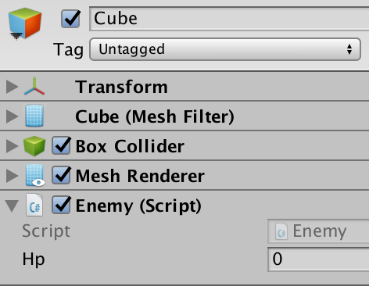
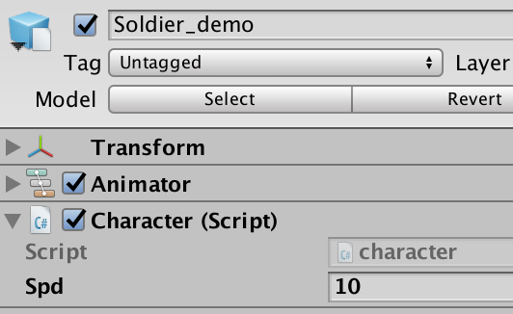
Refer to Other Components
BoxCollider, MeshCollider, SphereCollider, etc, same with the name of the component.
Referring to a script in another object is also possible from another object's script, example:

Slide 5
Refer to Another Script Var/Func
From Soldier_demo's character.cs, we can refer to public variable or function in the Enemy.cs
First, refer to the GameObject of the enemy, using:
Public GameObject in character.cs referred to an enemy
Using loop to find certain tag or name of the enemy
First way :
Enemy e = en.GetComponent<Enemy> (); e.reduceHp (20);
Second way :
GameObject[] arr = GameObject.FindGameObjectsWith Tag("enemy"); for (var i = 0; i < arr.Length; i++) { Enemy e = arr [i].GetComponent<Enemy> (); e.reduceHp (20); }

Slide 6
Finding game object with name/tag
GameObject.FindGameObjectsWithTag (previous example) -> returns array

