Slide 1
Basic Player and Enemy Movement
Kristo Radion Purba

Slide 2
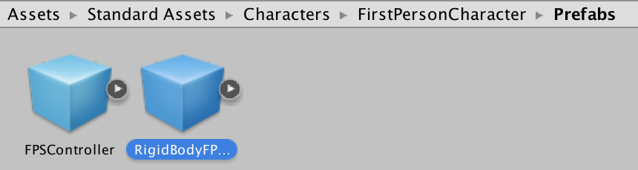
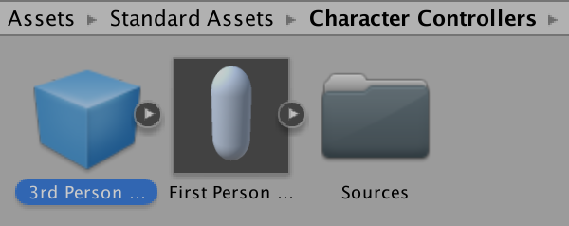
Using Default First or 3rd Person Player
Import the default Character asset in Assets -> Import Package -> Character
Put 3rd person controller or RigidBody FPS Controller in the stage, play the game
Control the character using WASD or arrow keys, and mouse direction.
Use space to jump

Slide 3
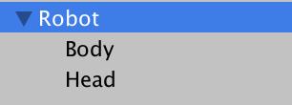
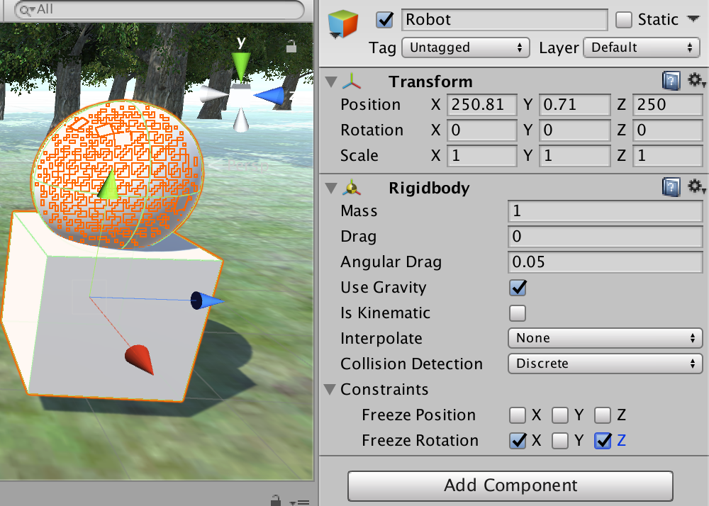
Creating Custom Basic Character
In this example, we will use C# programming in Unity to control our character.
First, create a character, e.g. robot, using cube and sphere
Then, add component Physics -> Rigid Body.
Set freeze rotation X and Z
-> Empty
-> Cube
-> Sphere

Slide 4
Rigid Body and Collider
RigidBody is for moving objects, allowing it to simulate physics like collision and gravity
Collider is used for moving objects and non-moving objects (like walls)
So for the player and enemy, we will use RigidBody so that they will collide to other objects, and affected by gravity, as well as Collider so other objects can collide them
For the robot example, the collider is already available in the head and body (sphere and cube), so we don’t need to add it.

Slide 5
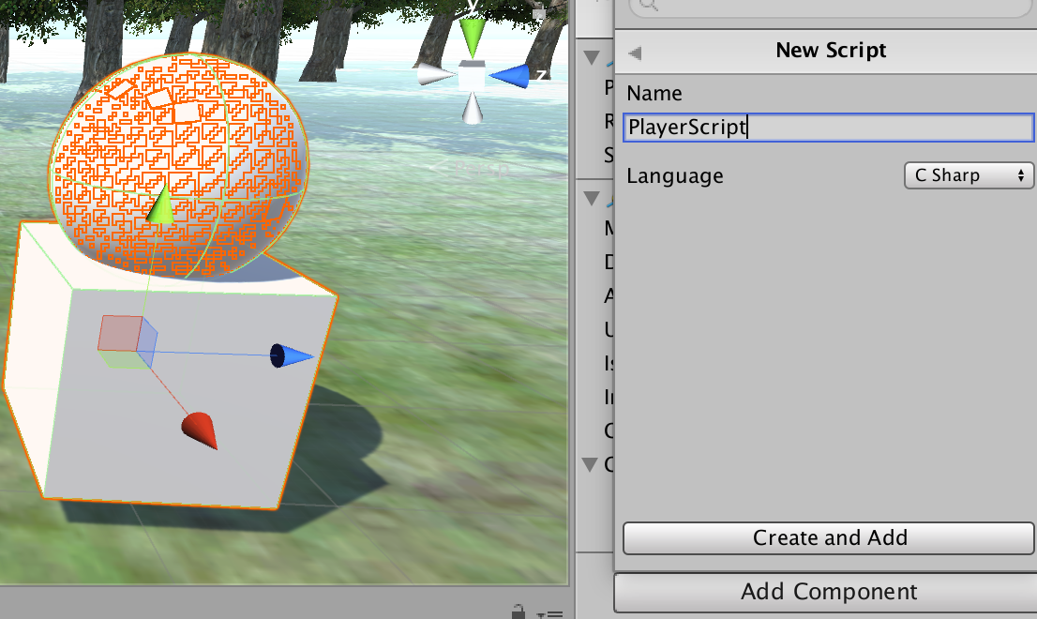
Player Movement
Add new script to the Player, name it PlayerScript, choose C# language

Slide 6
The Script
There are 2 basic events in the unity Script :
  Start : Happens once, when the first time the object appeared in the scene
  Update : Happening every frame. Default FPS (frame per second) in unity is 60. Thus, 1 frame is 1/60 second. The Update() will happen every 1/60 secs.
In this example, we will add the scripts in the update(). The character control will run every time as long as the game is running.

Slide 7
Player Script
Double click on the PlayerScript, then add the following in the void Update()
//Get the input from WASD, arrow, and joystick
//the value is between -1.0 and 1.0
float v = Input.GetAxis("Vertical");
float h = Input.GetAxis ("Horizontal");
//convert horizontal input to X, and vertical input to Z
var spd = new Vector3 (h, 0, v) * 0.2f;
transform.Translate (spd);
//MainCamera follows the player from distance (3rd person)
var cam = Camera.main;
//tilt the cam
cam.transform.rotation = Quaternion.Euler(new Vector3 (25, 0, 0));
//set the camera a bit away from the player
var camPos = this.transform.position + new Vector3(0,4,-5);
cam.transform.position = camPos;

Slide 8
More advanced movement controls are available at
Chapter 9. Third Person Controller

