Slide 1
Unity Drawing, Object, Terrain
Kristo Radion Purba

Slide 2
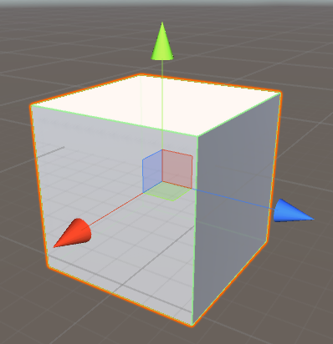
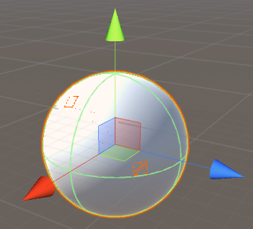
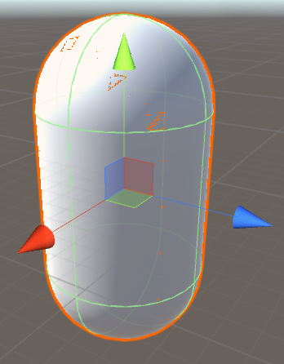
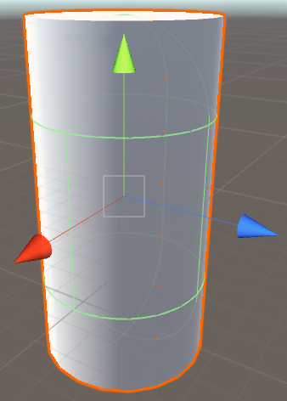
Basic 3D Objects
Commonly used basic 3D objects : Cube, Sphere, Capsule, Cylinder
Game object -> 3D Object -> ..

Slide 3
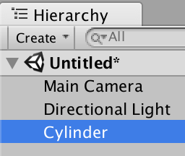
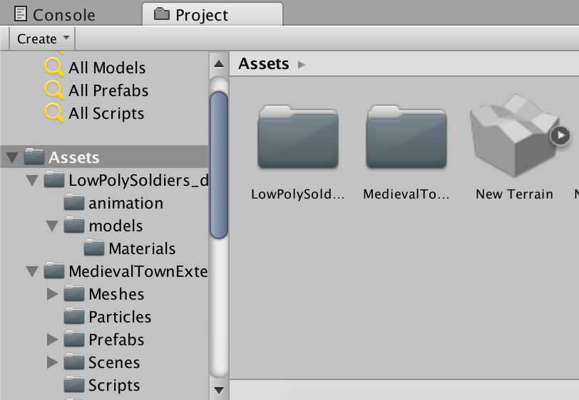
Hierarchy and Project Folder
Hierarchy : Anything that is placed in the current Scene.
Project folder : Saved objects, i.e. prefabs, all imported assets, audio files, etc.

Slide 4
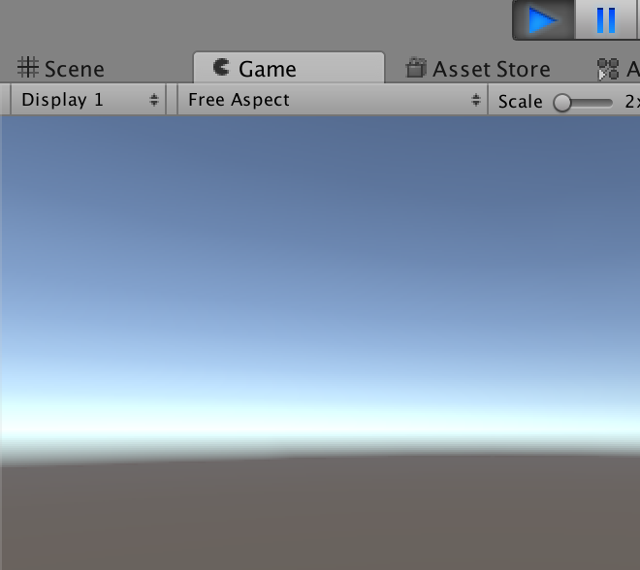
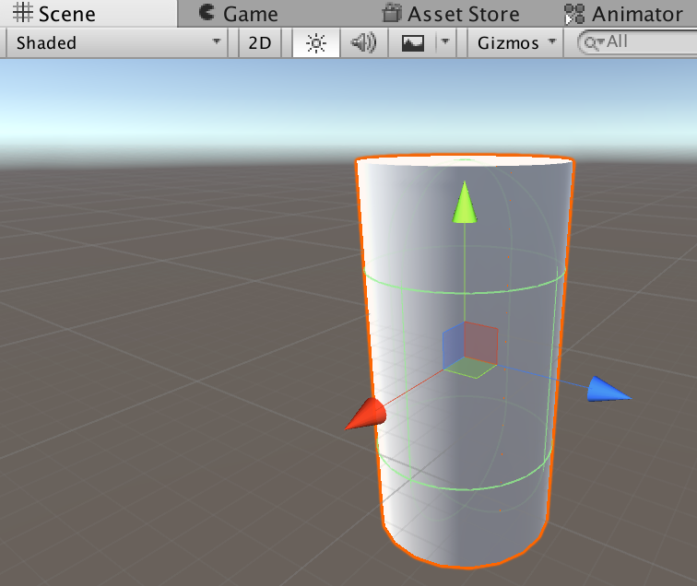
Scene and Game Tab
Scene : A panel to put objects that will be available in the Game
Game : The game preview. Press play to run the game.

Slide 5
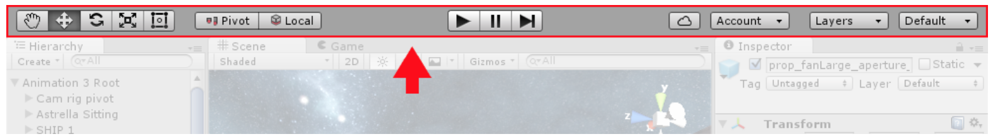
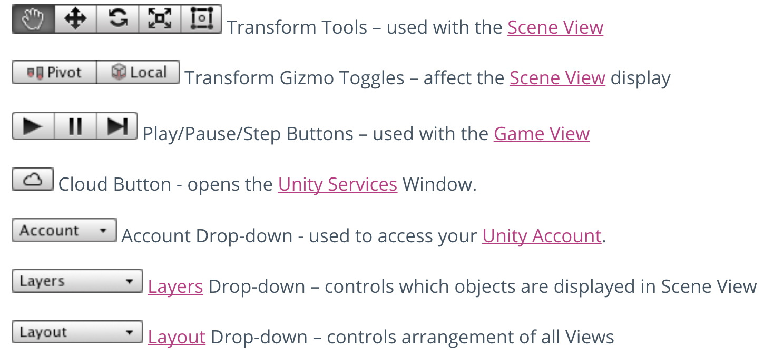
Using the Toolbar

Slide 6

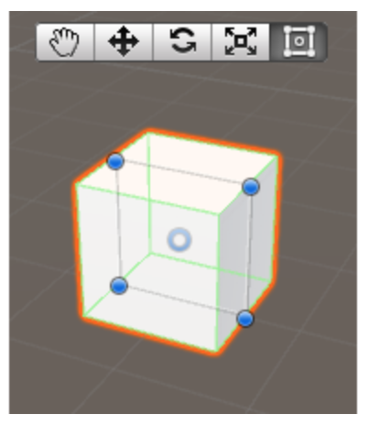
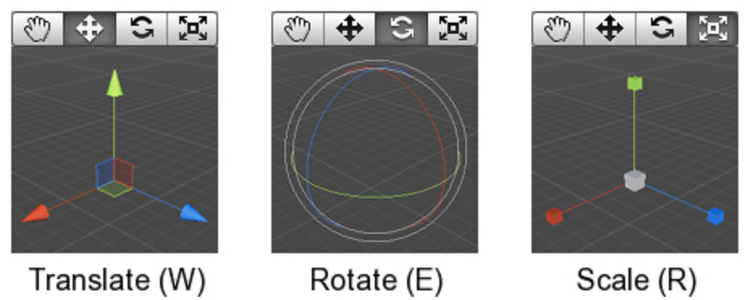
Transform Tools
Hand tool : To drag the screen
Rect Transform (T)
Additional control :
Hold mouse right click, drag to look around in the scene
Hold mouse right click, press WASD or arrow to move around, hold Shift to go faster

Slide 7
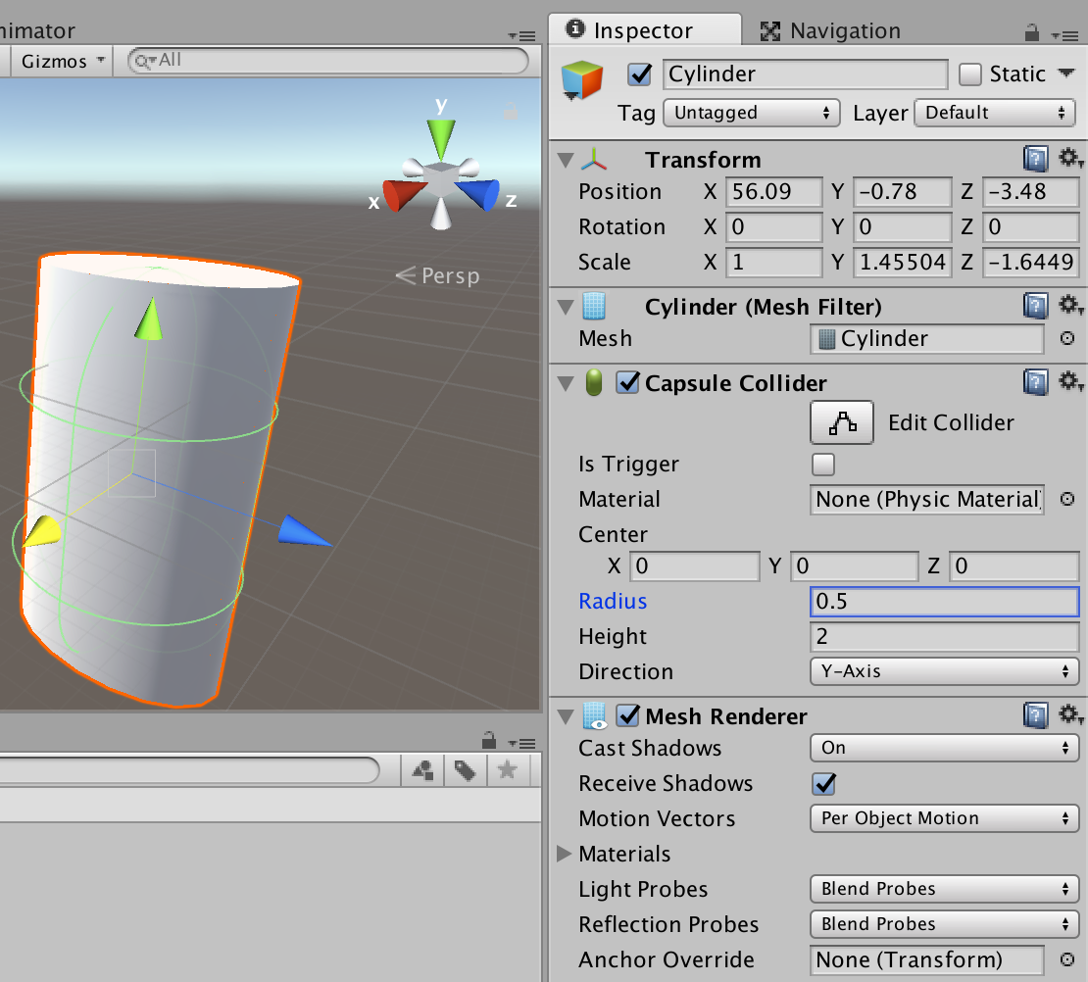
Inspector Panel
Used to check information about the clicked/selected object in scene :
Transform : Position, rotation, scale
Attached components, e.g. a cylinder can have colliders, renderer, script, etc.

Slide 8
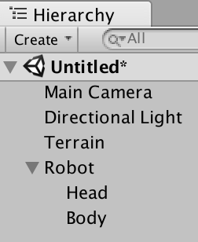
Combining Objects
Objects can be assigned as a child of another object
Empty object can be useful to combine objects. GameObject -> Create Empty, after that drag the object to the Empty (in Hierarchy). Try renaming it to "Robot"
Tips : Object can be renamed using F2 (Windows) or Enter (Mac)

Slide 9
Creating Terrain
Terrain is the base plate for the map. Alternatively, we can use Plane, but plane cannot be raised/lowered.
Terrain features :
Changing width/height
Raise/lower
Add texture : Grassland, snowy land, etc
Add trees (random mass placing or by brushing)

Slide 10
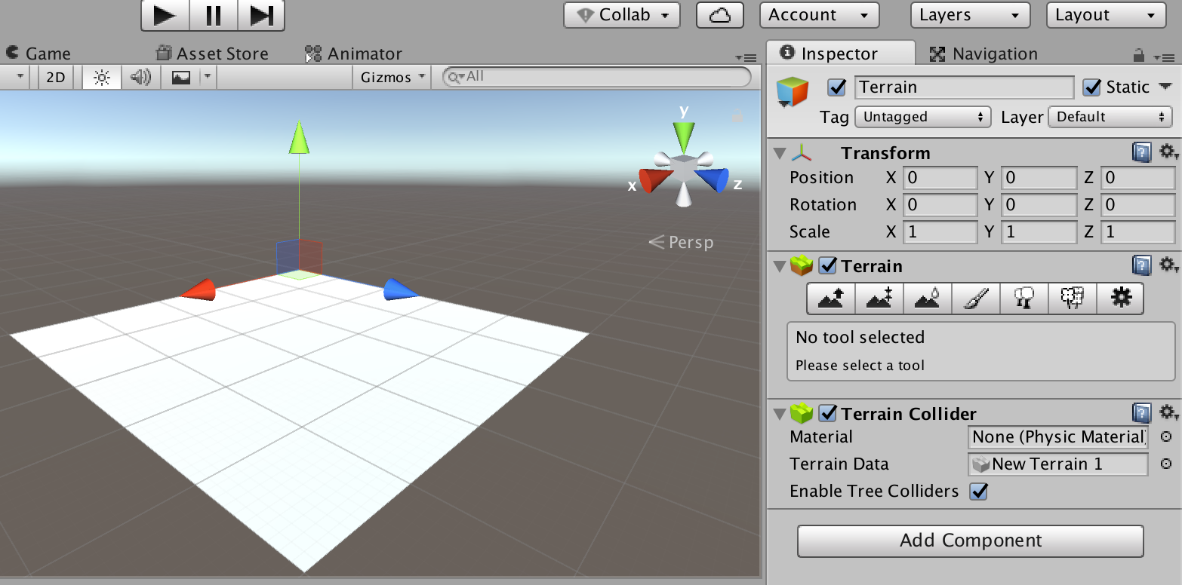
Initial Terrain

Slide 11
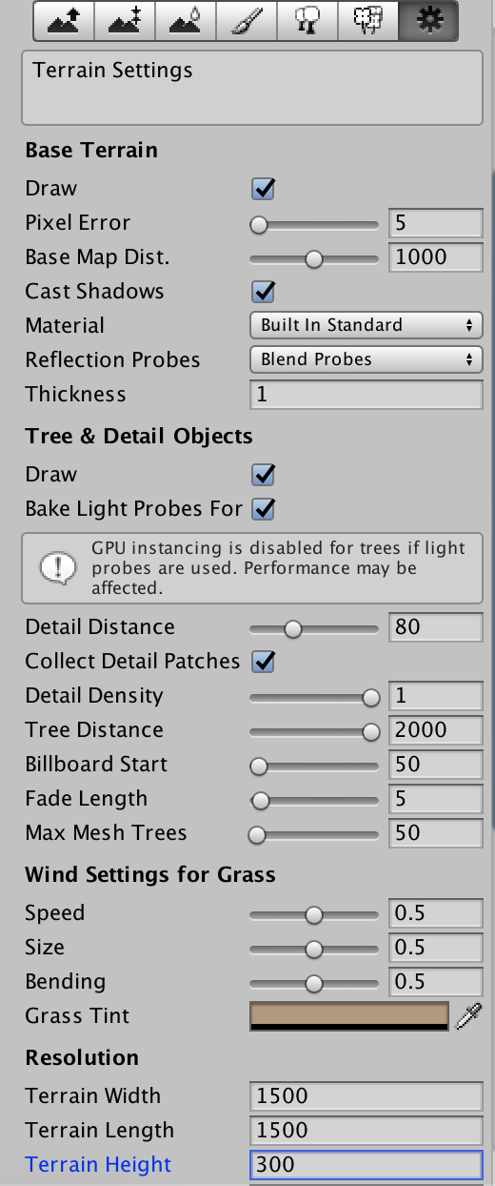
Terrain Setting (Inspector)
Terrain width and length : The size of the terrain
Terrain height : The thickness of the terrain, only affects when we already raise/lower the parts of the terrain

Slide 12
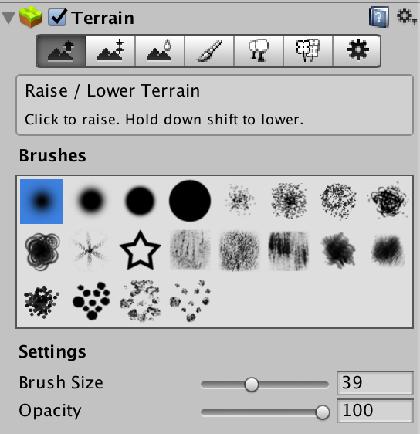
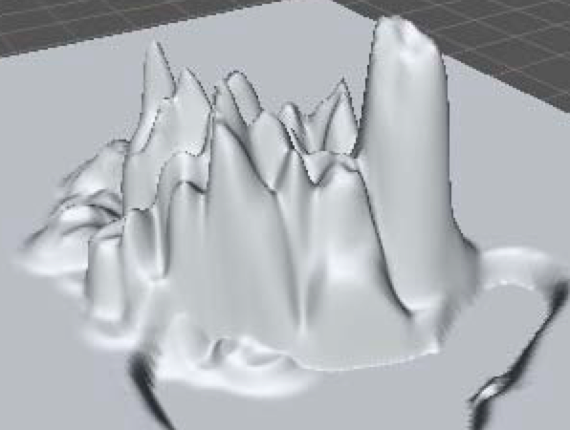
Raise/lower terrain
Brushes (type)
Brush size
Opacity (intensity)
Raise terrain : Click/hold mouse left button
Lower terrain : Hold shift, then click/hold mouse left button

Slide 13
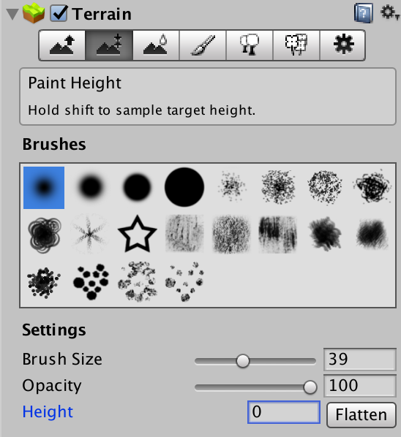
Changing the base height
The height variable is used to change the base height of the terrain, so that we can create valleys/rivers on the terrain
0 is the default height
Change the number, click flatten to raise the base height of the terrain

Slide 14
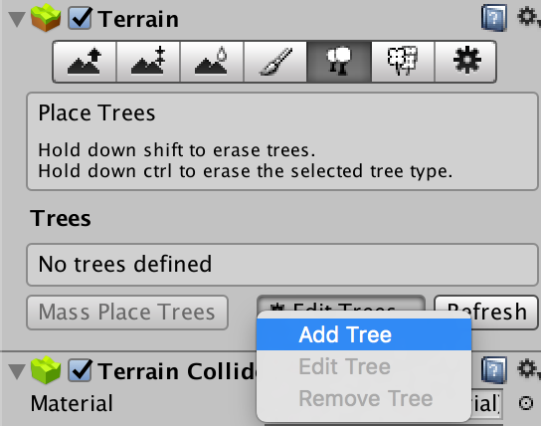
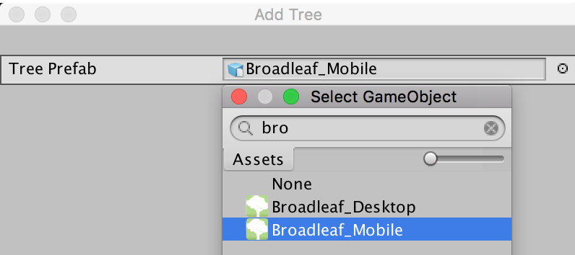
Placing Tree
First, we need to add tree asset. We can use the default asset found in Asset -> Import Package -> Environment
Then, select the tree using the 5th button in terrain inspector
Select one of the tree (use the small circle button)

Slide 15
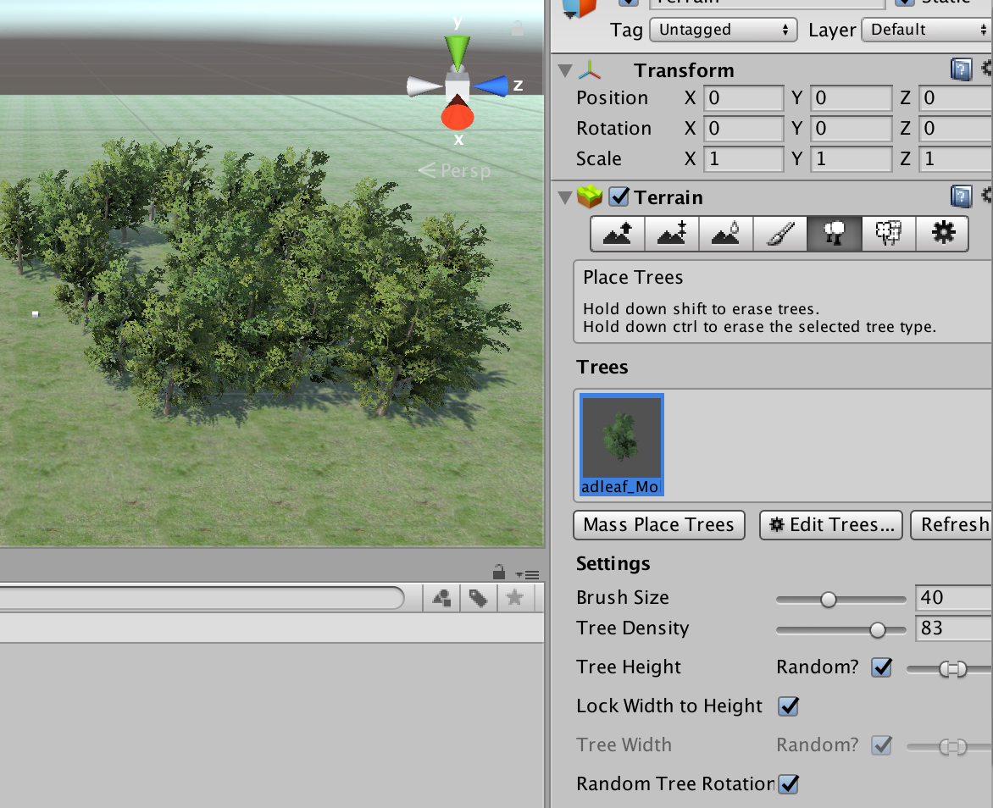
Placing Tree (2)
Then, use the brush to add trees
Or, use mass place tree button spread random trees

Slide 16
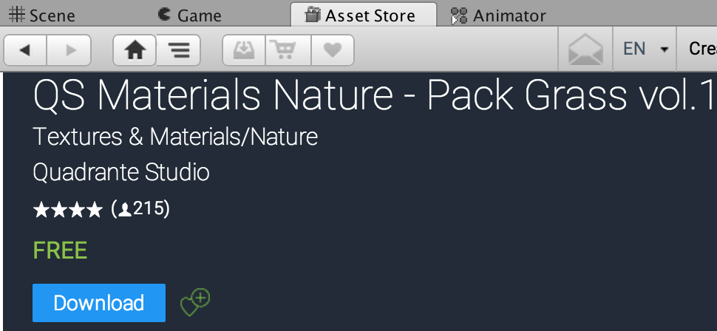
Terrain Texture
Texture can be assigned to terrain. In this example, we will use grass texture to create grassland
Download assets in : kristora.com/els
Double click on the .unitypackage file
In this example, we will use QS Materials Nature - Pack Grass vol1.unitypackage, or available in the Unity Asset Store

Slide 17
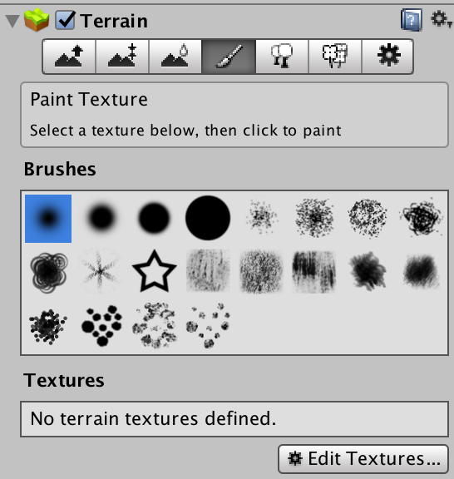
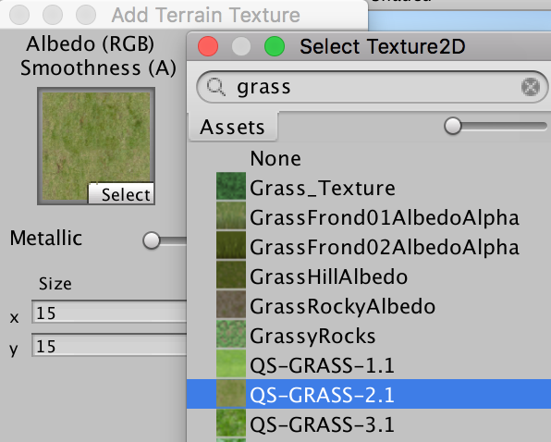
Assigning Texture to Terrain
Click the 4th button on the Terrain inspector, select edit texture, then add texture
Click select on the Albedo (RGB), then pick one of the grass texture

Slide 18
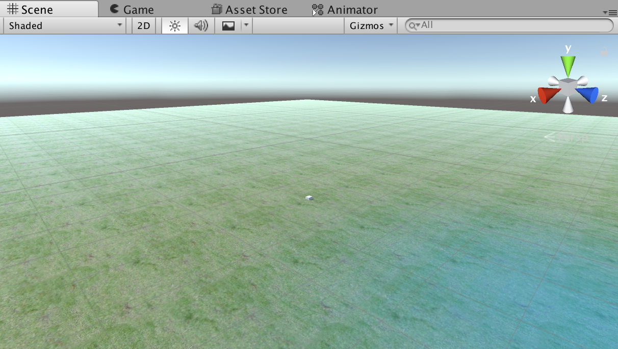
Grassland Terrain

Slide 19
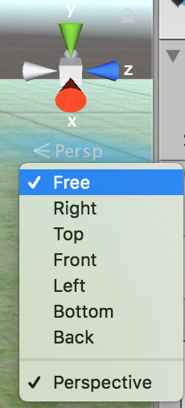
Scene View (Scene Gizmo)
Scene gizmo controls current orientation, and allows you to quickly modify the viewing angle and projection mode.
Click one of the X, Y, Z or the Perspective button to change the view. Right click on the perspective button to see available views

Slide 20
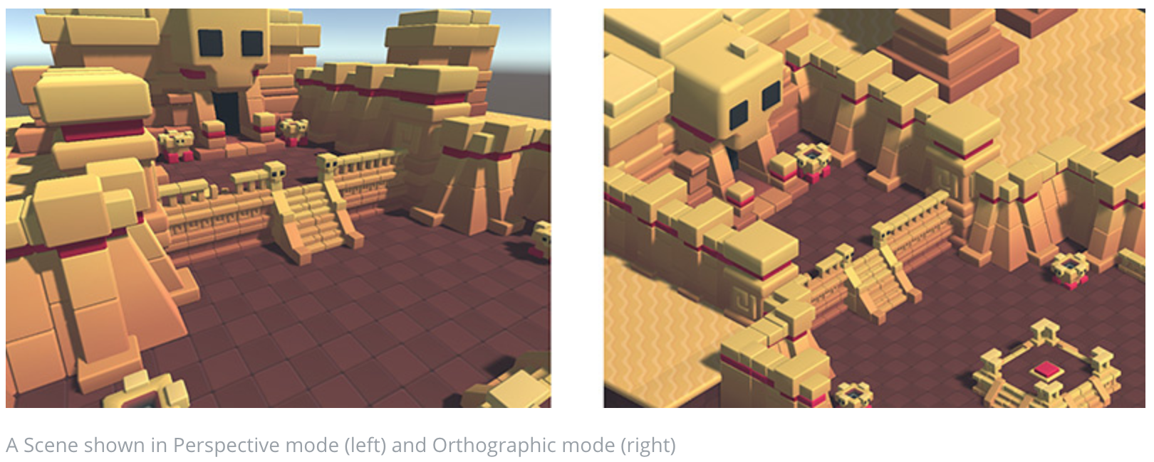
Perspective or Orthographic View
Perspective View
Orthographic View
(Uncheck perspective in scene gizmo)

